Slide 1
Upper Airway CFD Findings
Disclaimer: The CFD findings presented here are intended solely for educational purposes. They do not constitute medical advice, diagnosis, or treatment. The analyses reflect modeling assumptions and cannot replace a clinical evaluation. Always consult your licensed healthcare provider regarding any questions about your health, diagnosis, or treatment options. Do not ignore or delay seeking professional medical advice because of something presented here.

Slide 2
Table of content
Introduction to CFD: Slides 3-10
Case overview: Slides 11-24
Pressure findings: Slides 25-28
Nasal cavity analysis: Slides 29-33
Velocity findings: Slides 34-36
Turbulence findings: Slides 37-47

Slide 3
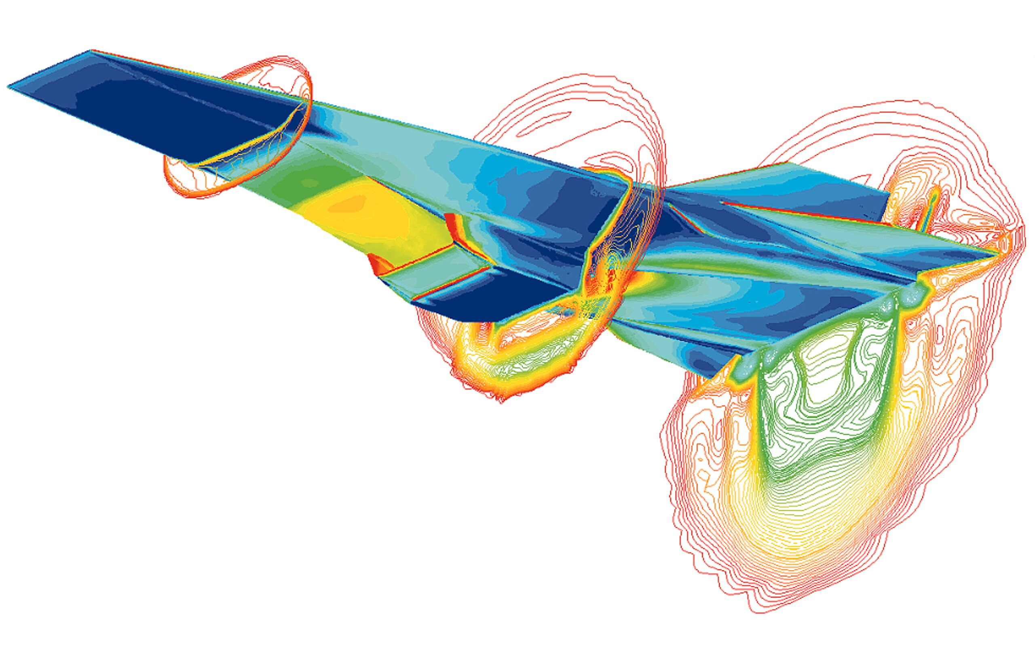
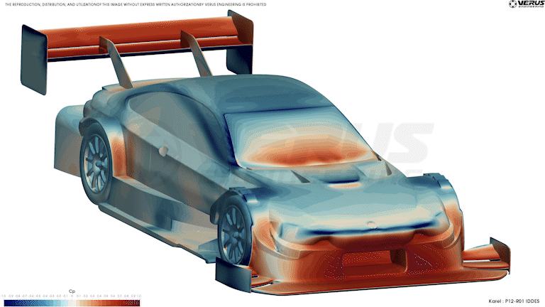
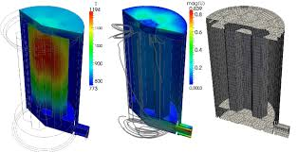
What is a computational fluid-dynamics (CFD) analysis ?

Slide 4
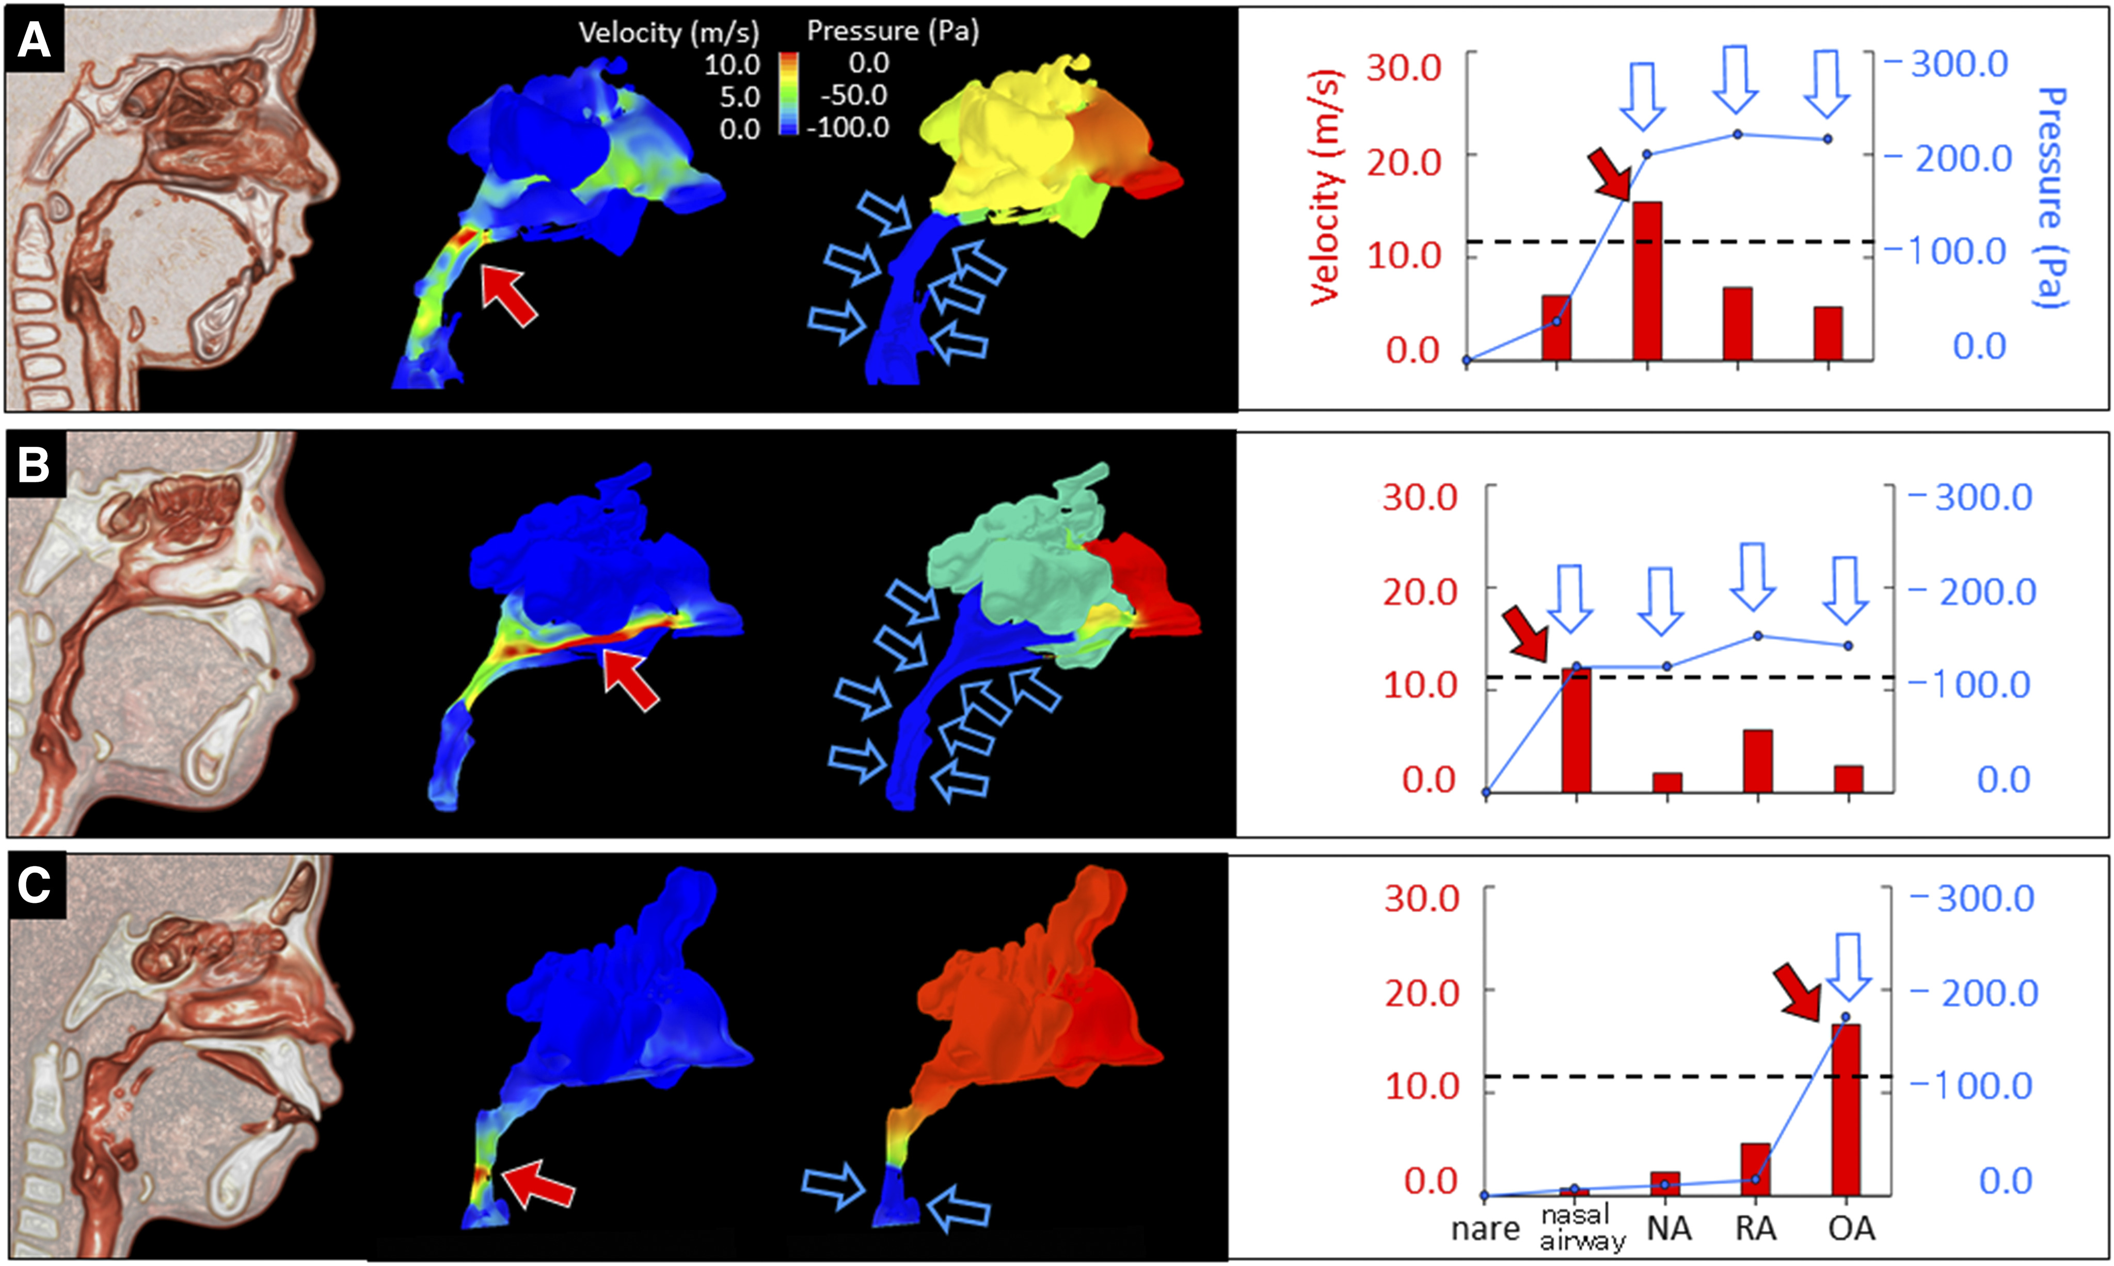
CFD and Sleep Disordered Breathing
Yanagisawa-Minami A, Sugiyama T, Iwasaki T, Yamasaki Y. Primary site identification in children with obstructive sleep apnea by computational fluid dynamics analysis of the upper airway. J Clin Sleep Med. 2020;16(3):431–439.

Slide 5
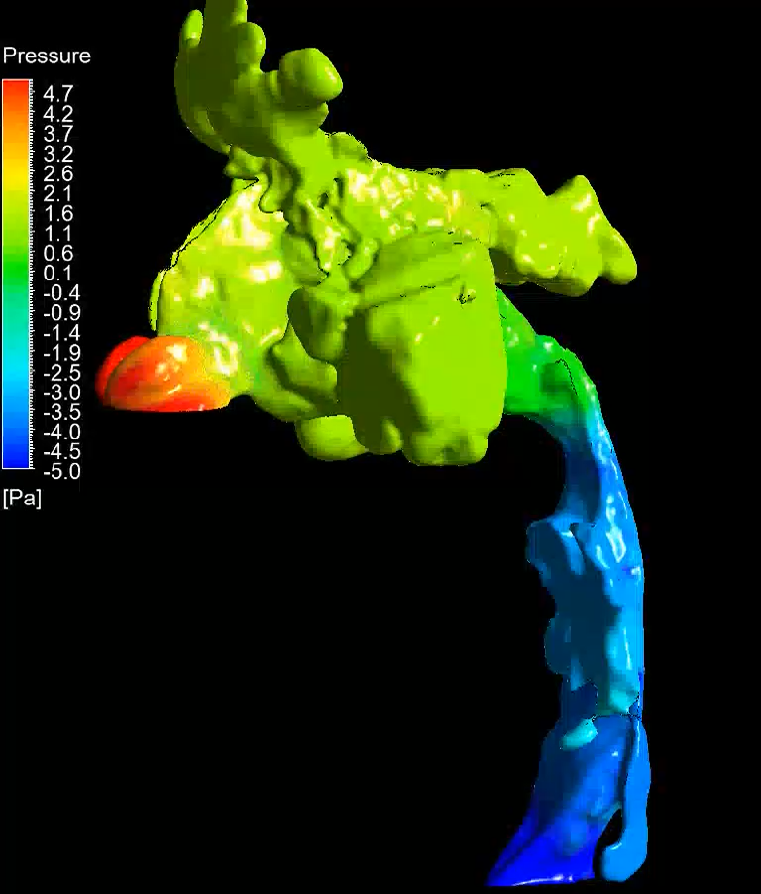
1. Pressure

Slide 6
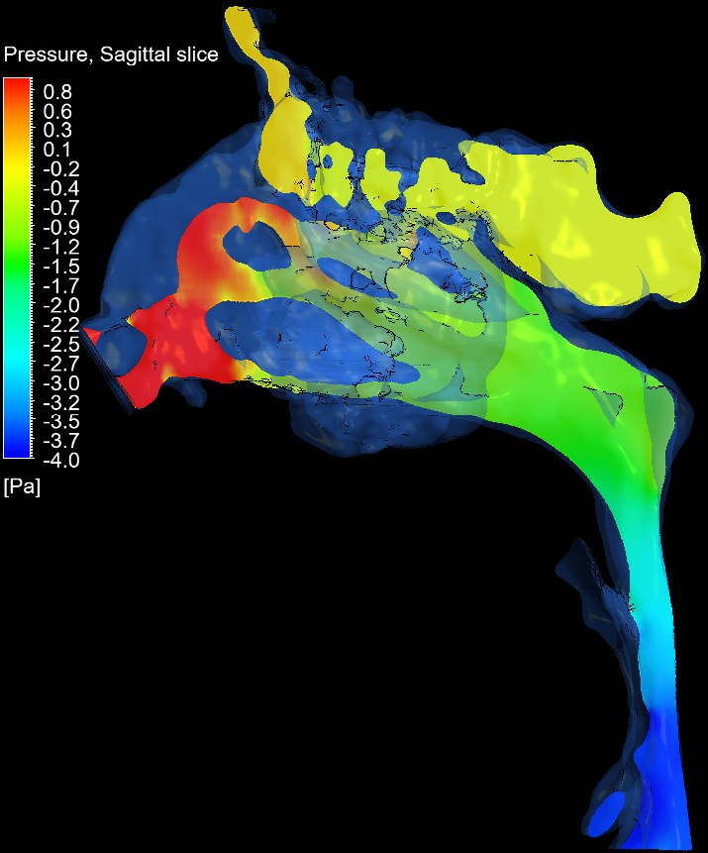
1. Pressure

Slide 7
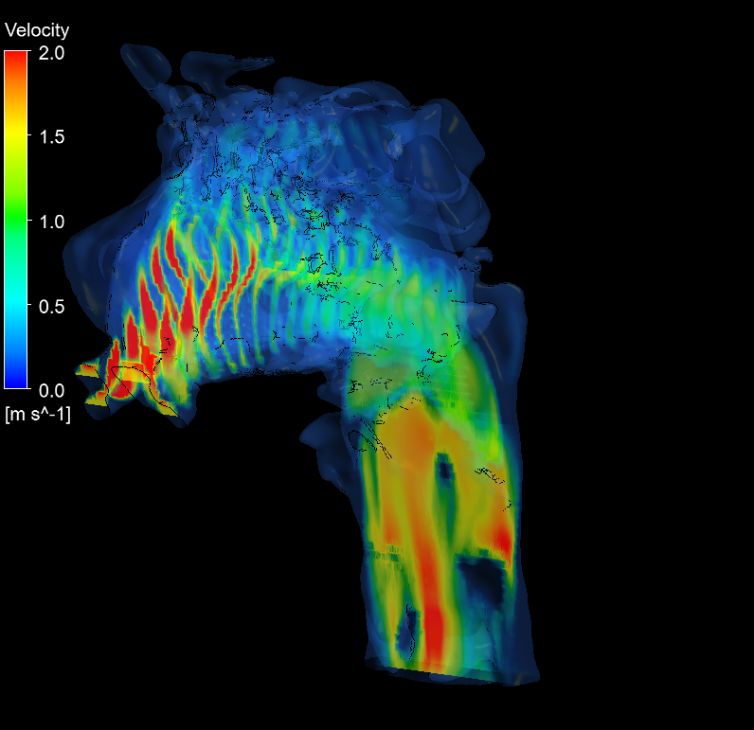
2. Velocity

Slide 8
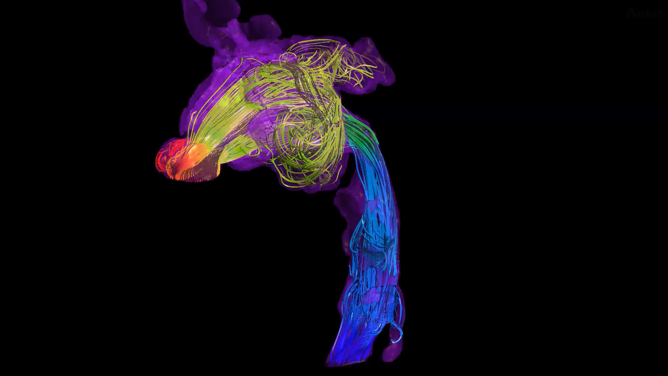
3. Turbulence

Slide 9
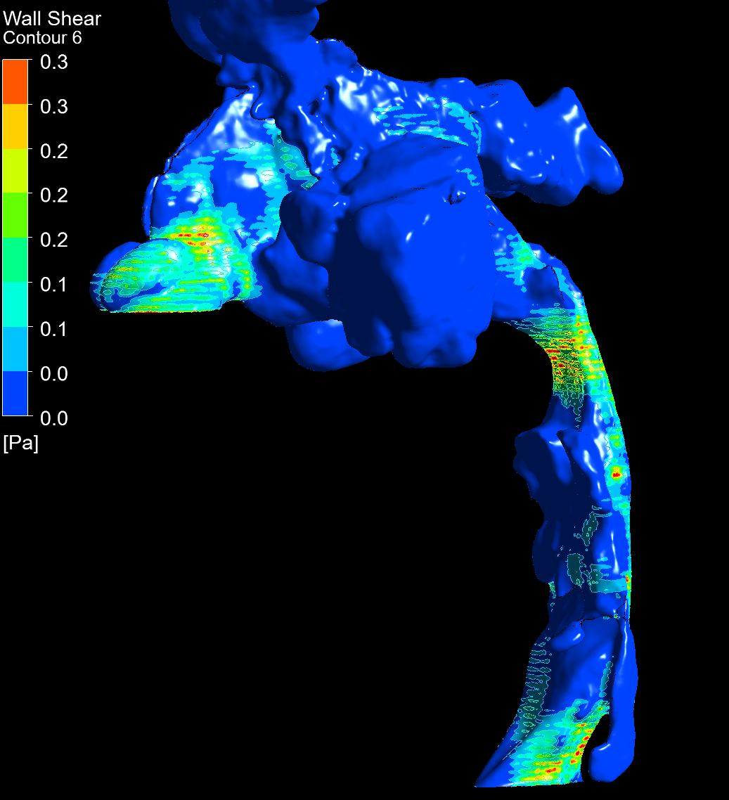
4. Wall shear

Slide 10
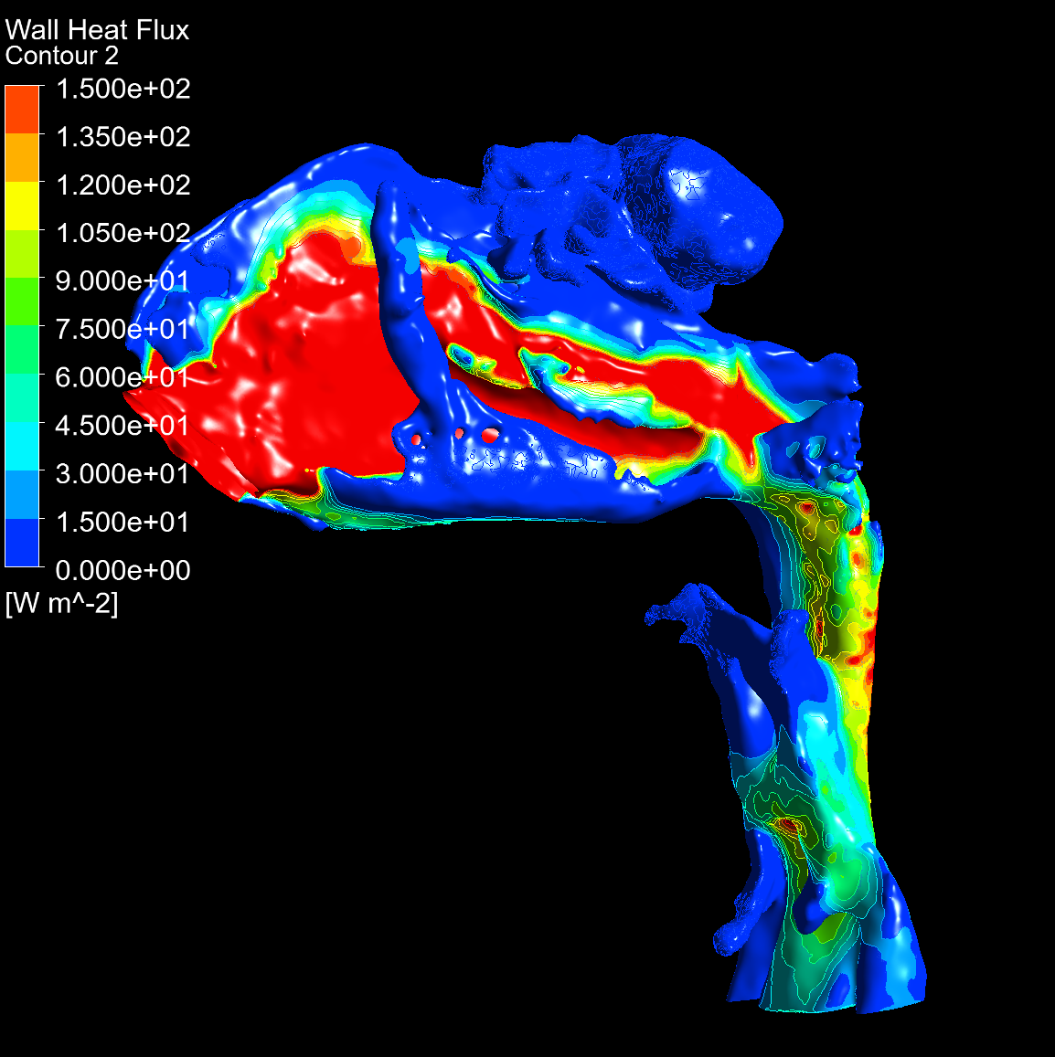
5. Heat flux

Slide 11
1. Case overview
The CFD was conducted on two CBCT scans, one conducted prior to and one after maxillary expansion. The CBCT scans (slides 12-15) show a narrowing of the airway in the lower naso- and the oropharynx, both pre and post expansion. Slides 16-18 show the effect of expansion on the nasomaxillary complex. Slides 19 and 20 measure nasal aperture pre and post expansion, while slides 21-24 show nasal cavity anatomy at different cross sections.

Slide 12
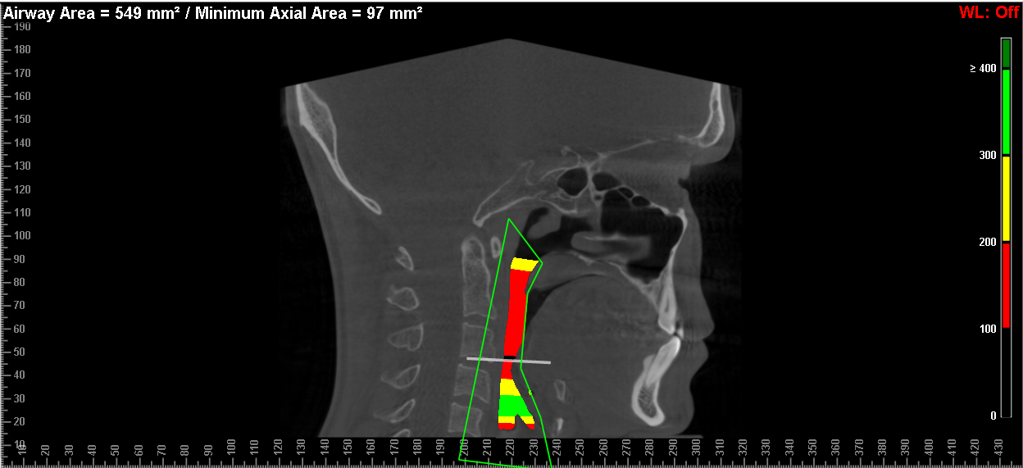
2017 CBCT

Slide 13
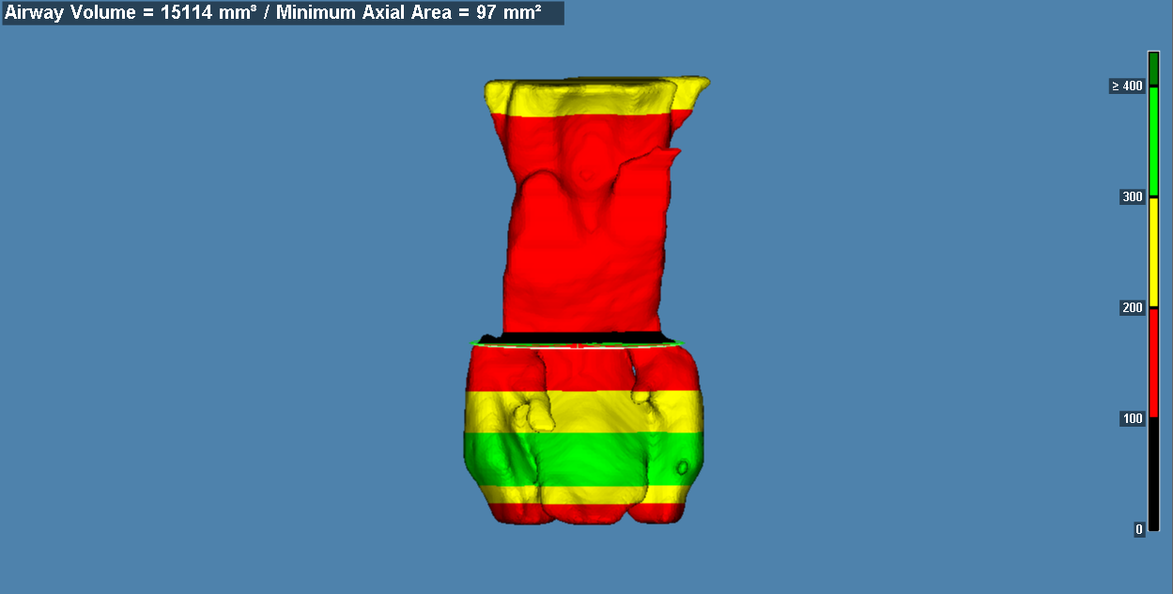
2017 CBCT

Slide 14
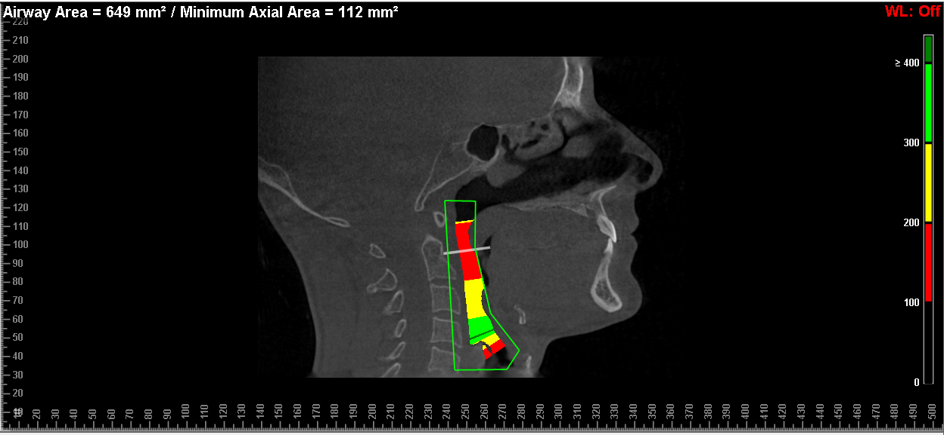
2024 CBCT

Slide 15
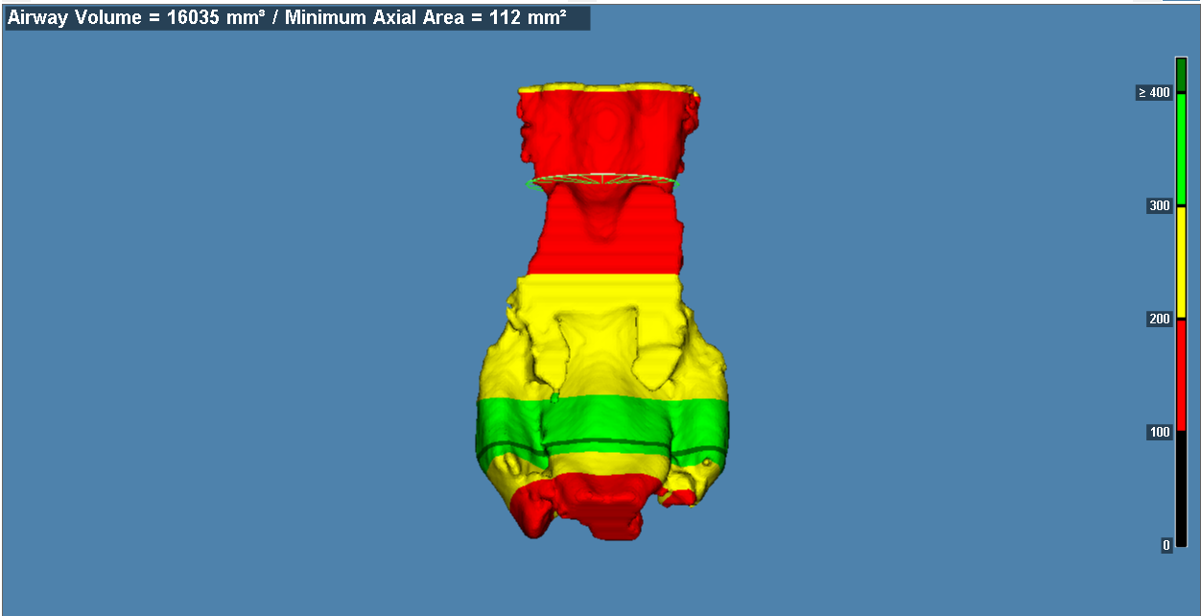
2024 CBCT

Slide 16
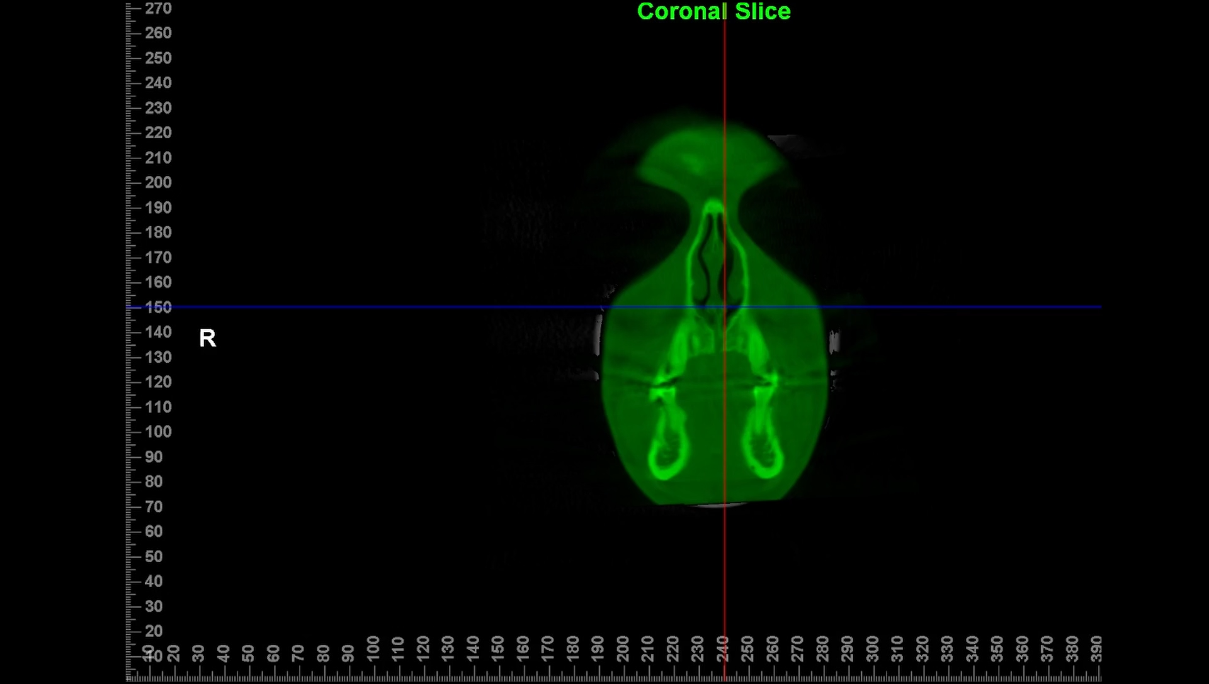

Slide 17
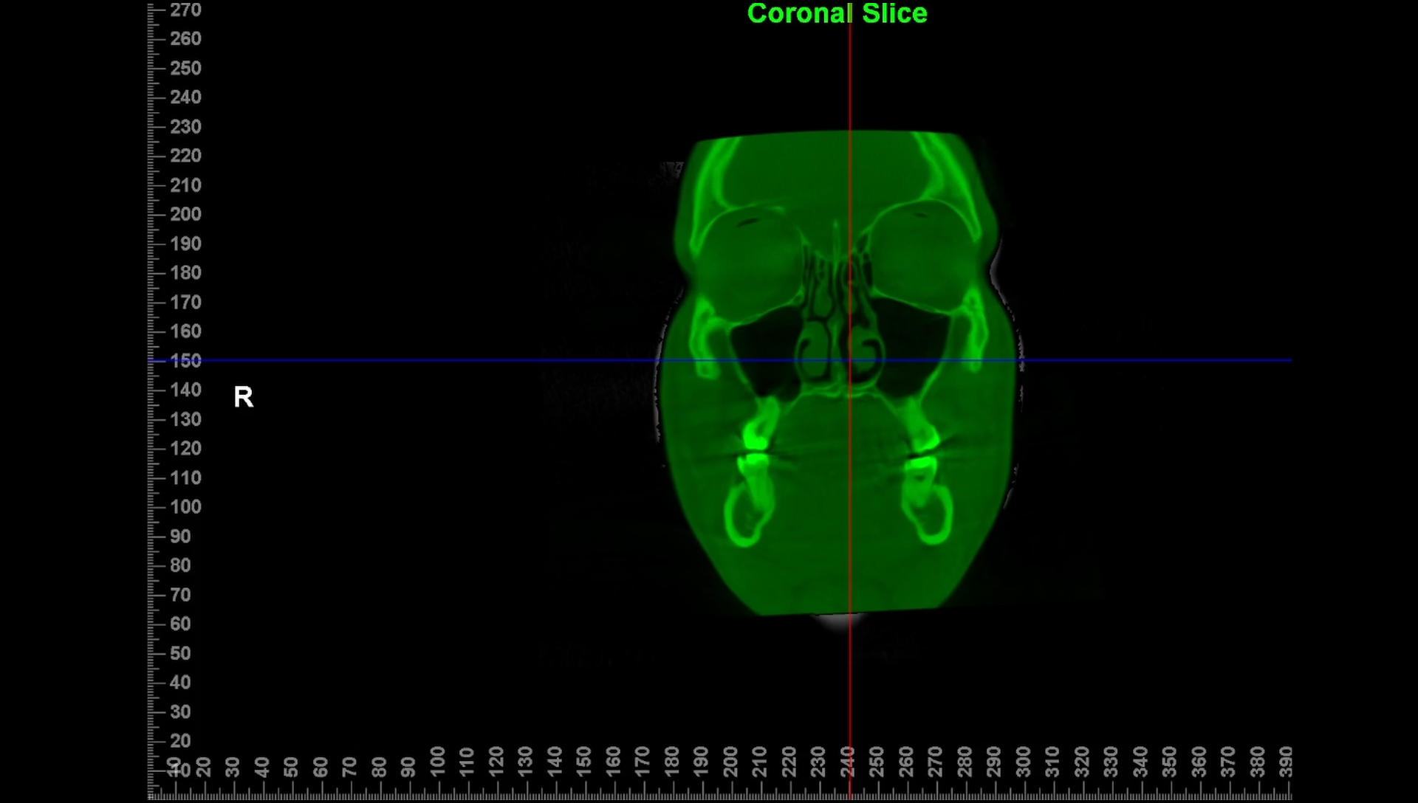

Slide 18
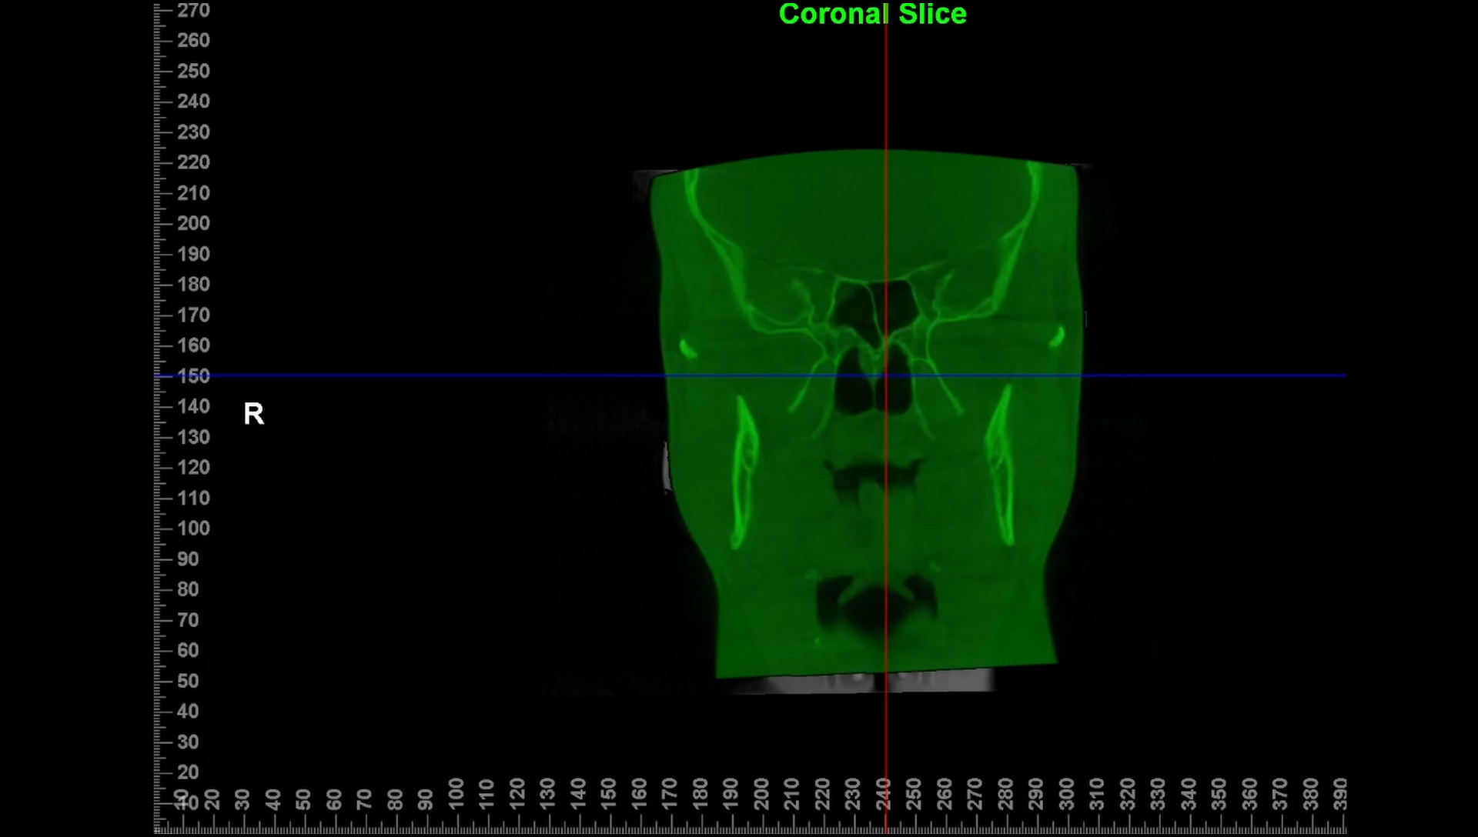

Slide 19
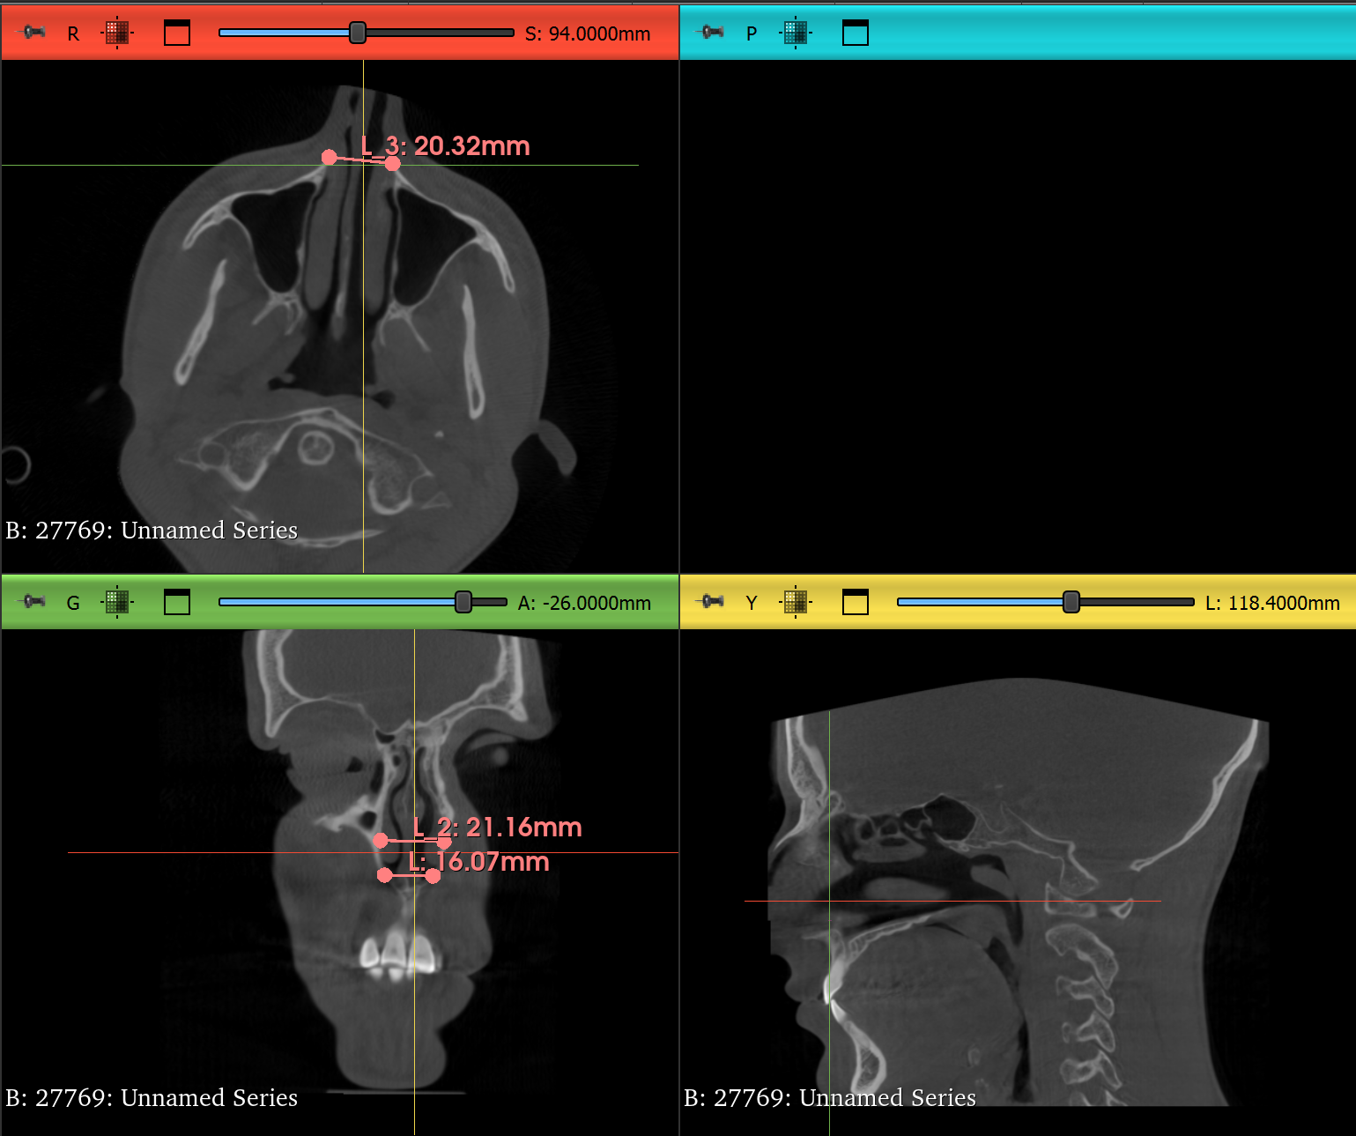
Pre-expansion, 2017
Nasal aperture measurements

Slide 20
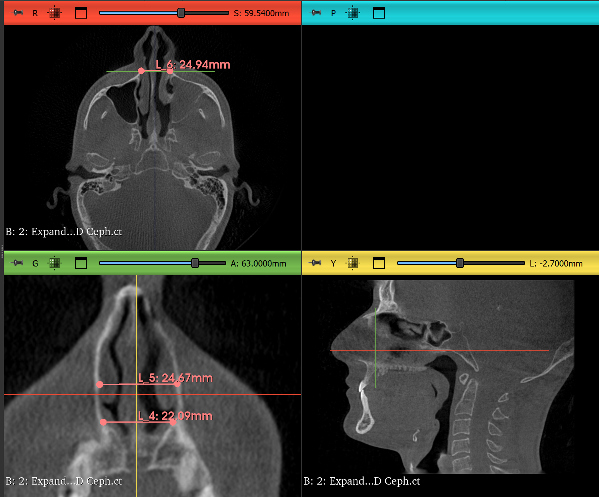
Post-expansion, 2024
Nasal aperture measurements

Slide 21
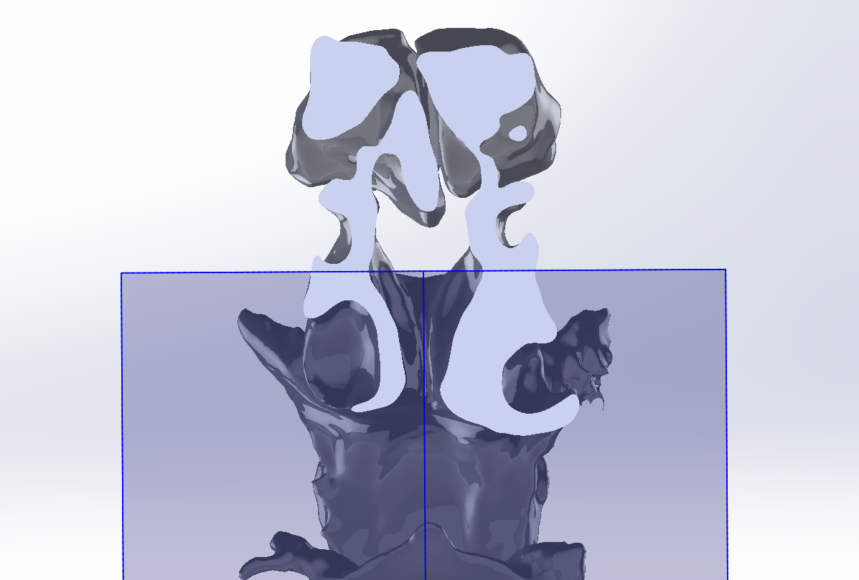
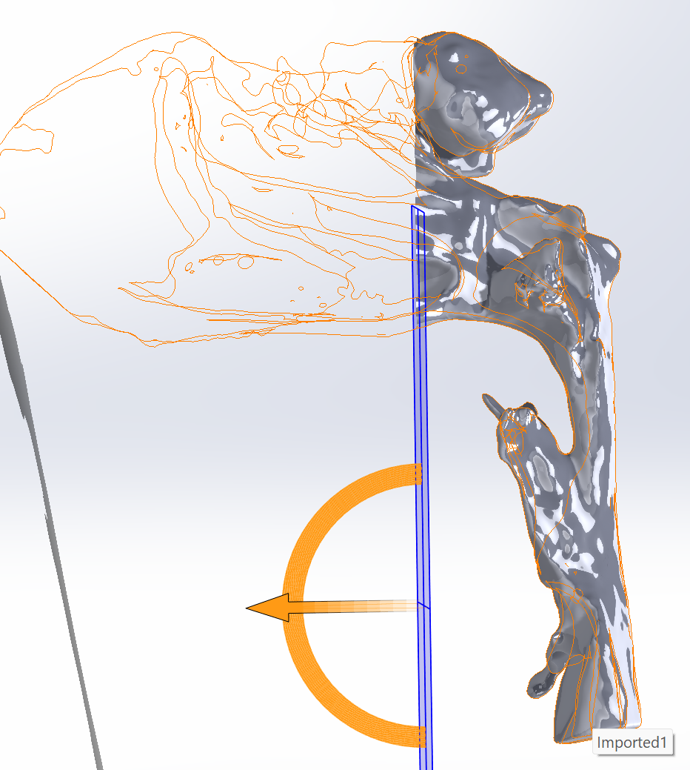

Slide 22
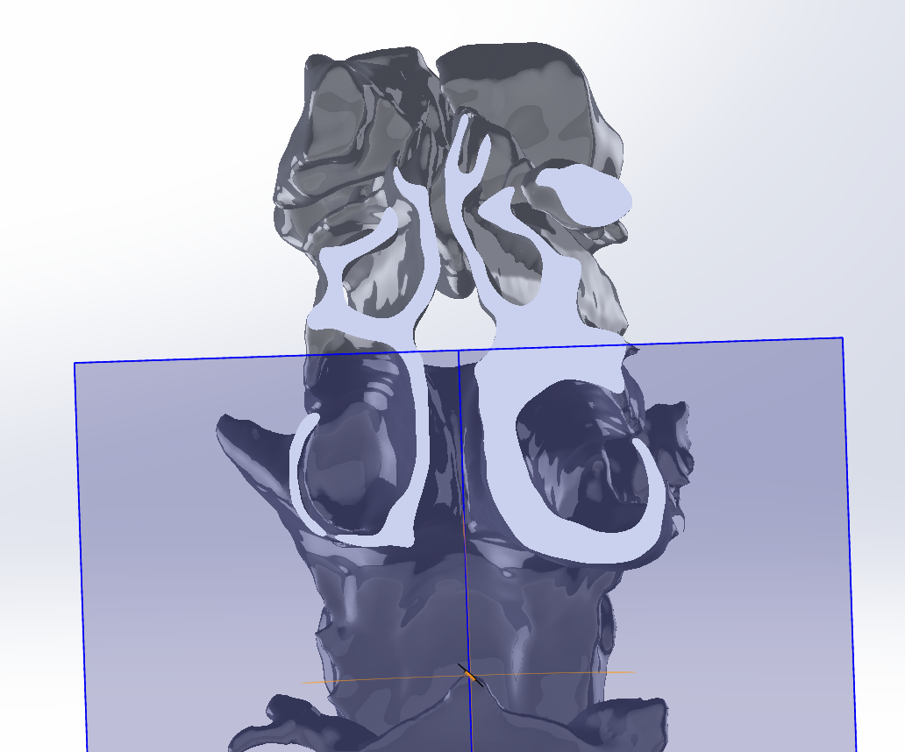
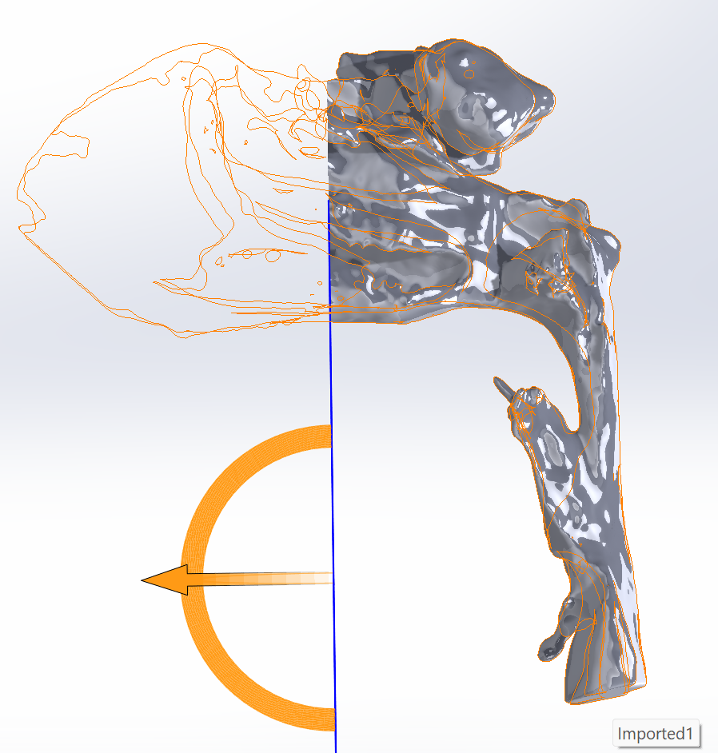

Slide 23
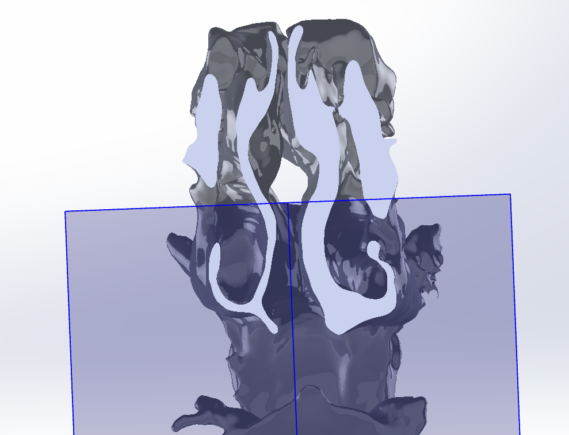
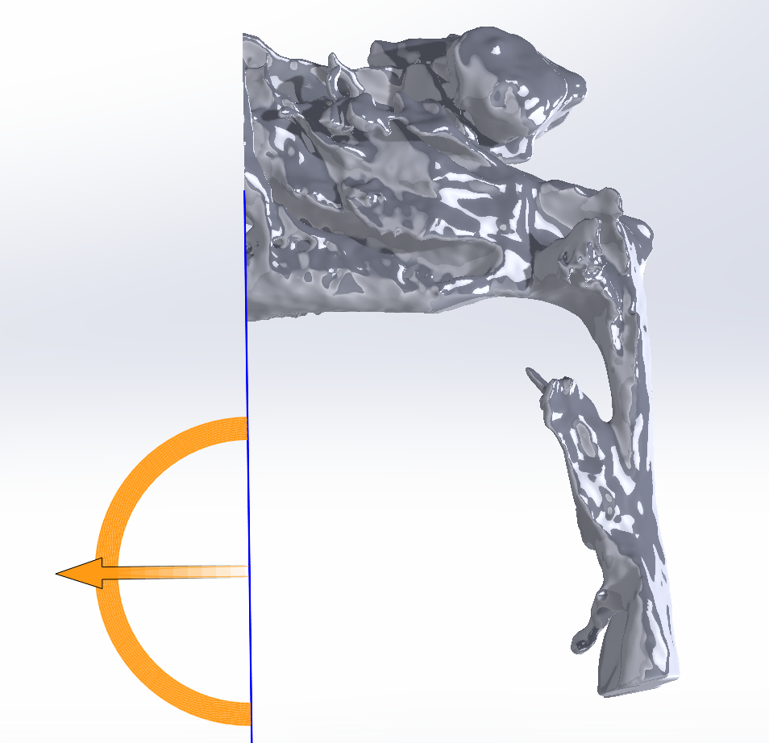

Slide 24
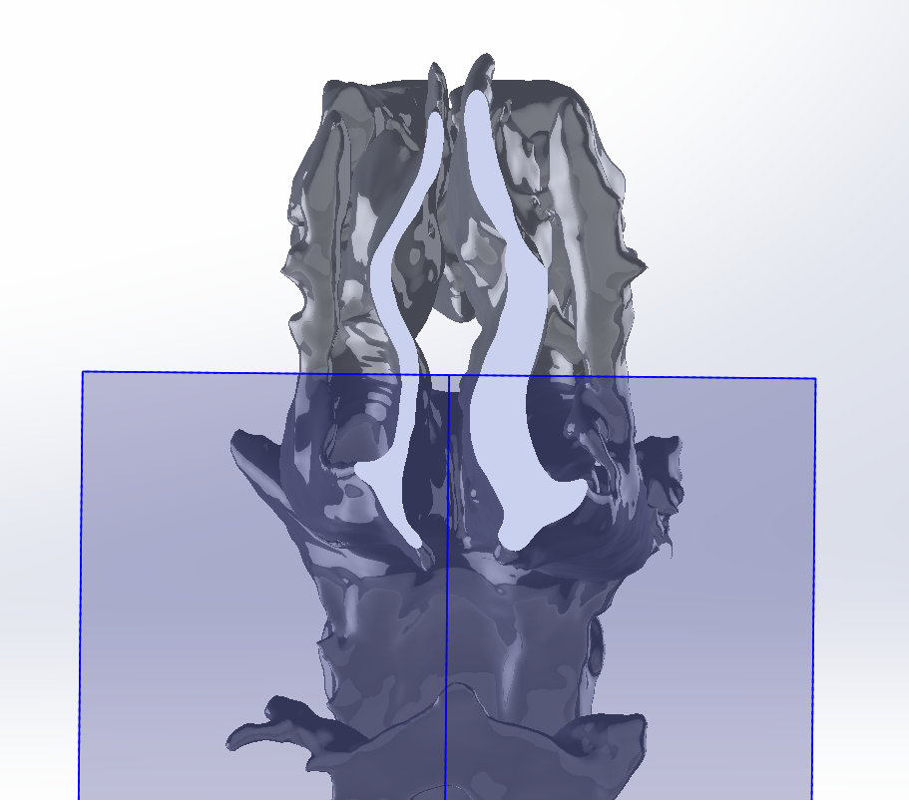
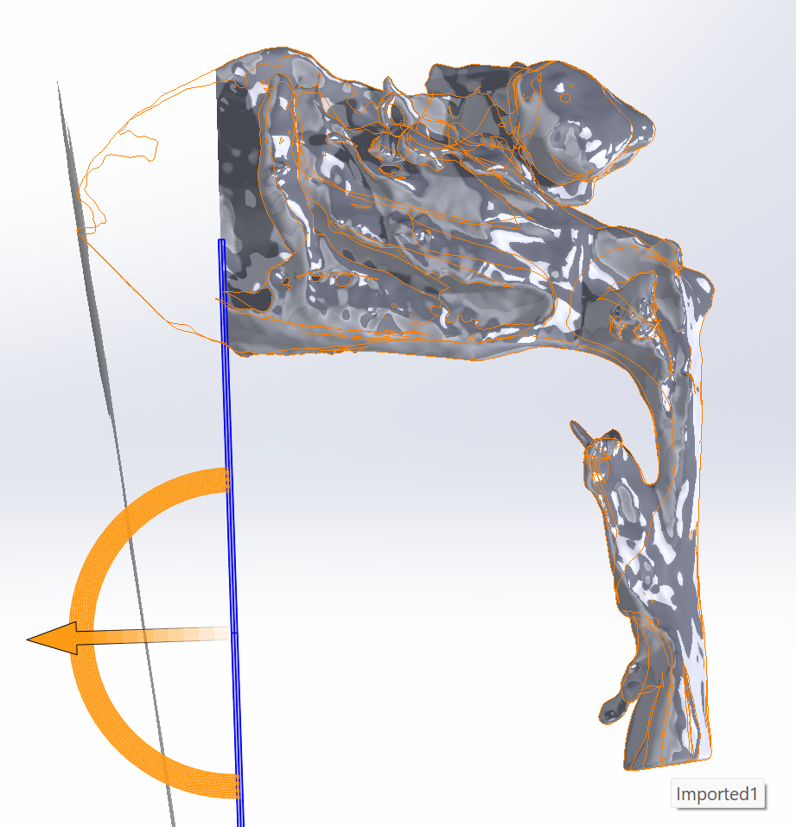

Slide 25
2. Pressure findings
Overview of pressure observed on the walls of the airway.

Slide 26
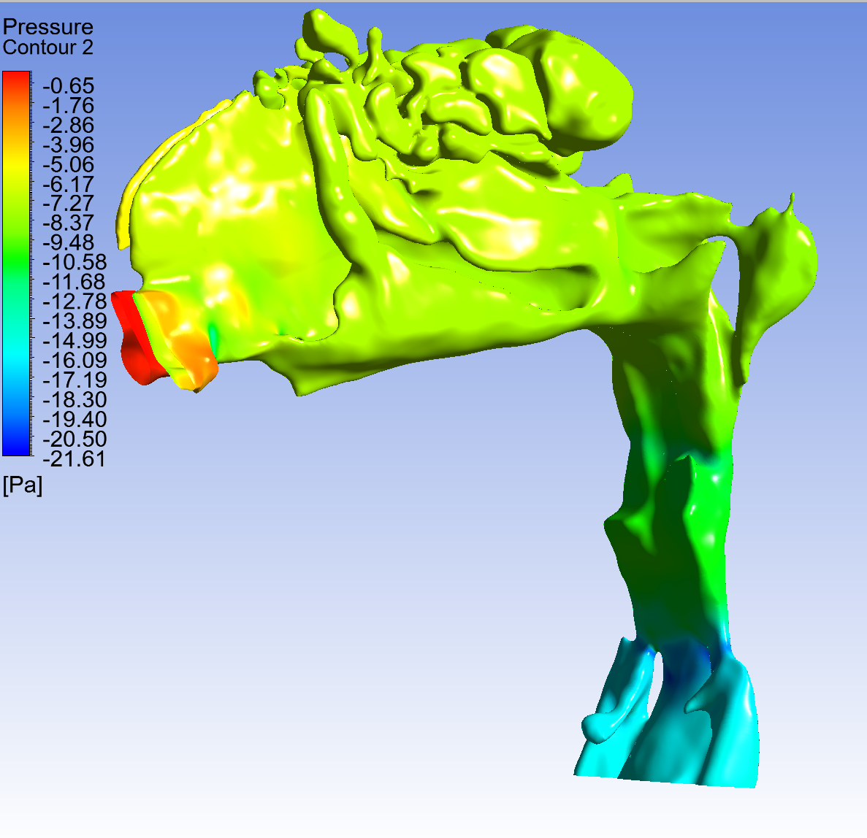
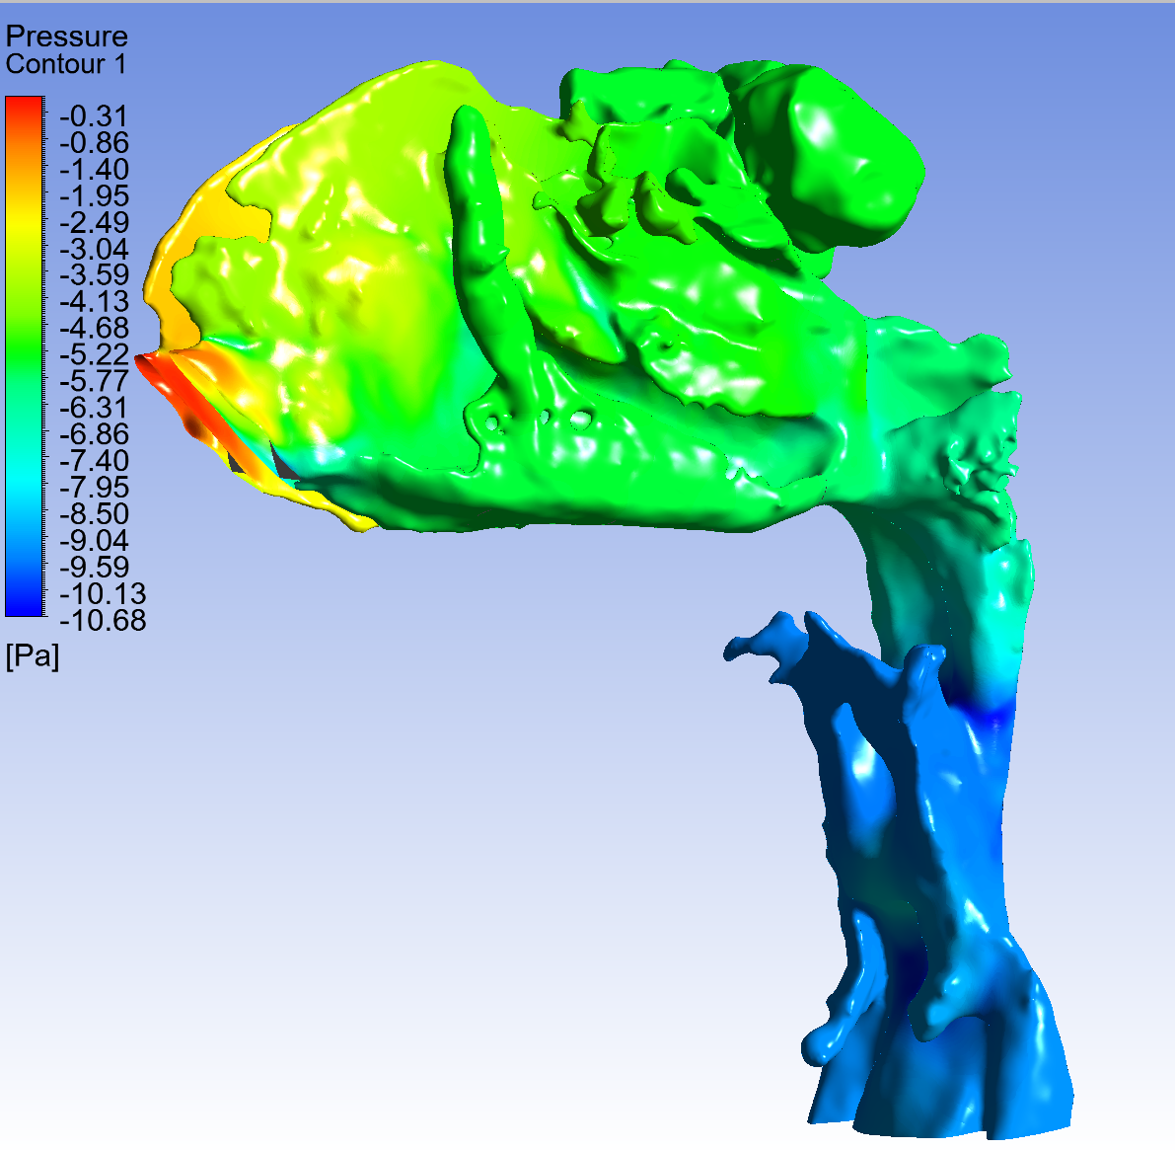
Figures 1+2. Pressure contour with maximum and minimum pressures modeled, pre- vs. post expansion
Higher negative pressures observed pre-expansion than post-expansion. More gradual pressure drops post-expansion than pre-expansion. Steep pressure drops in transition from naso- to oropharynx in both cases.
Pre-expansion
Post-expansion

Slide 27
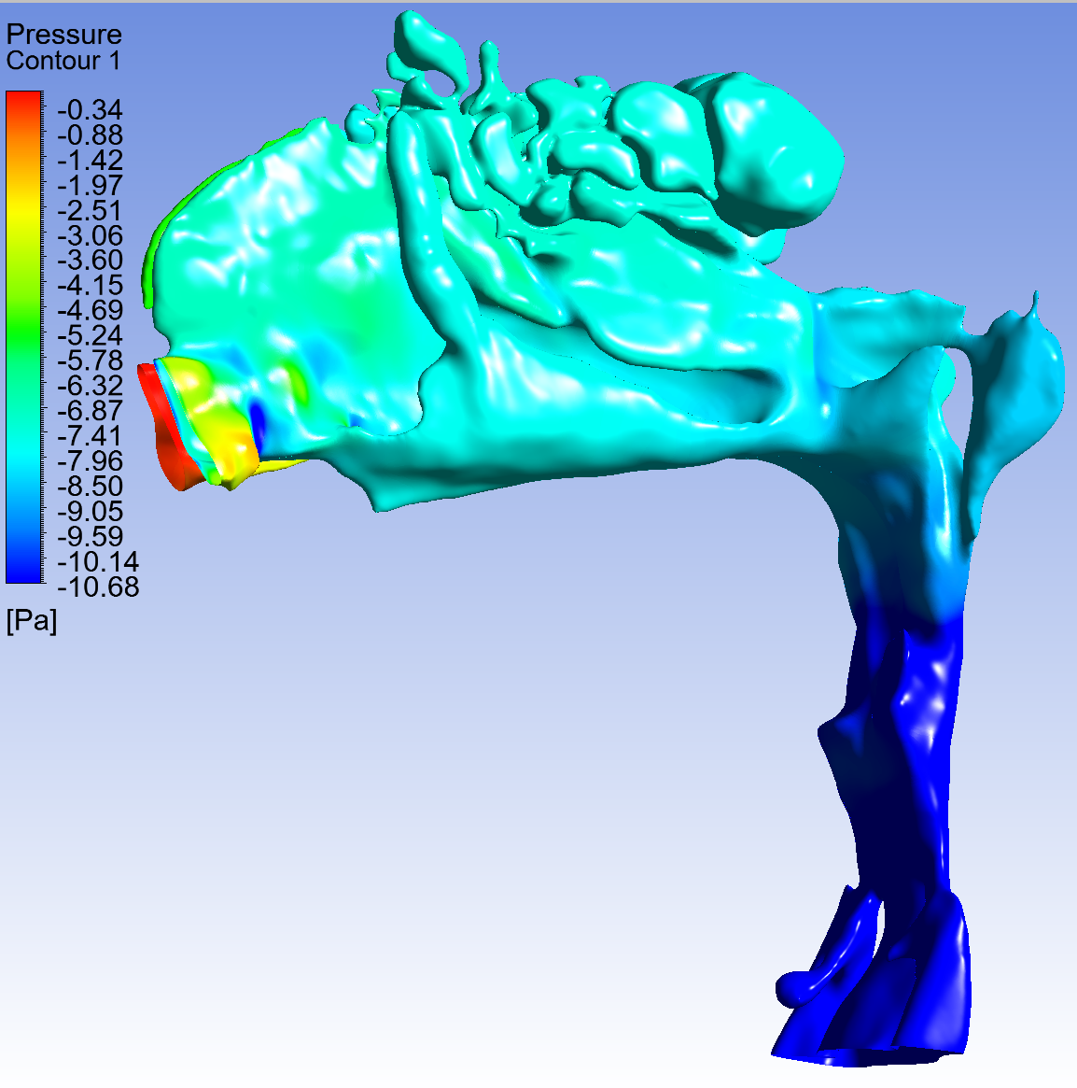
Figure 3. Pressure contour pre-expansion with truncated minimum pressure
Steeper pressure drop than post-expansion. Higher minimum pressure in nasal cavity than post-expansion.
Pre-expansion
Post-expansion

Slide 28
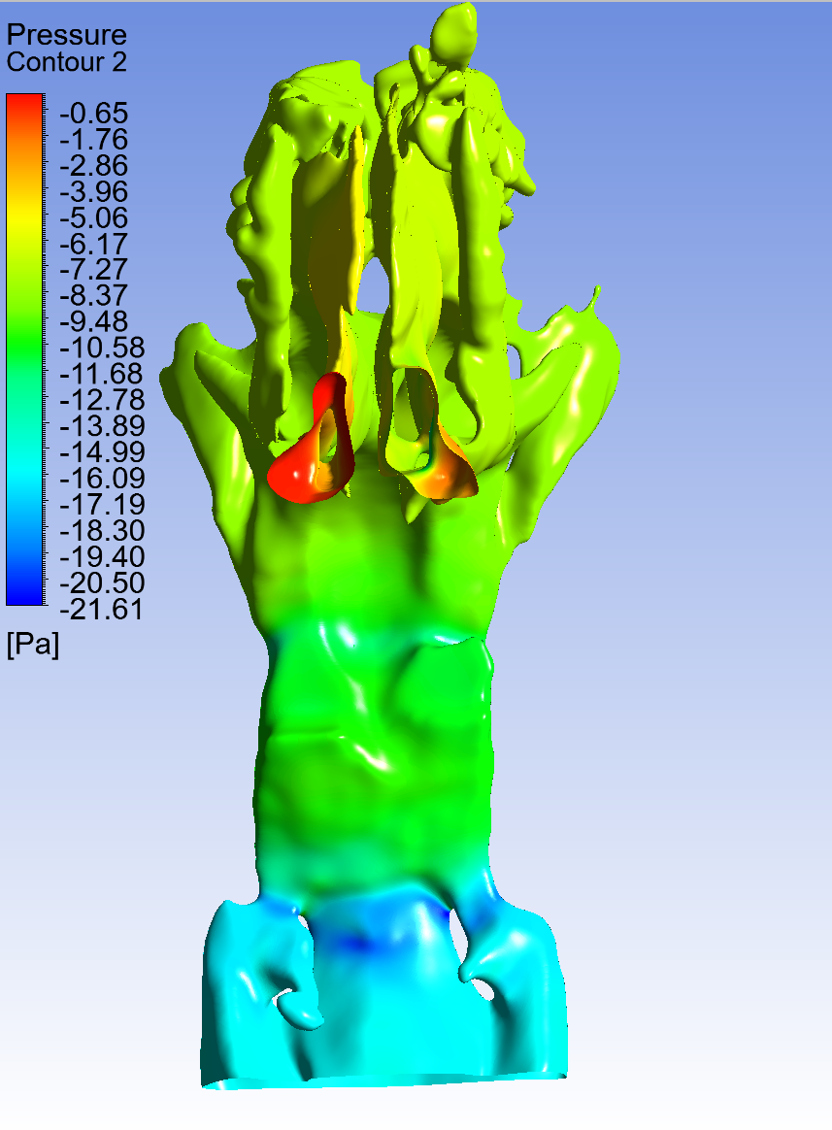
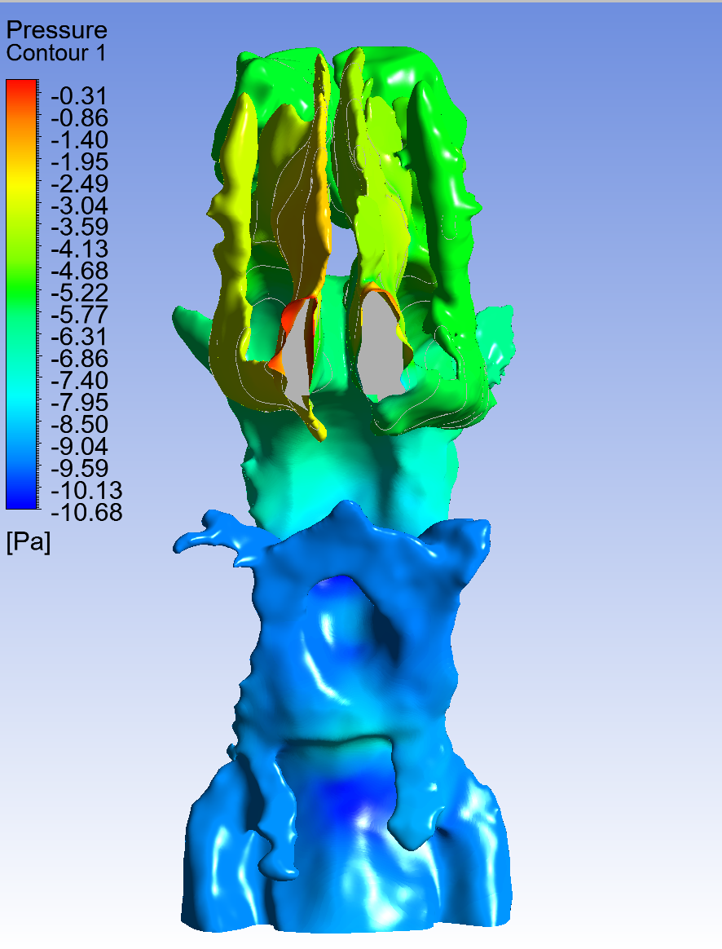
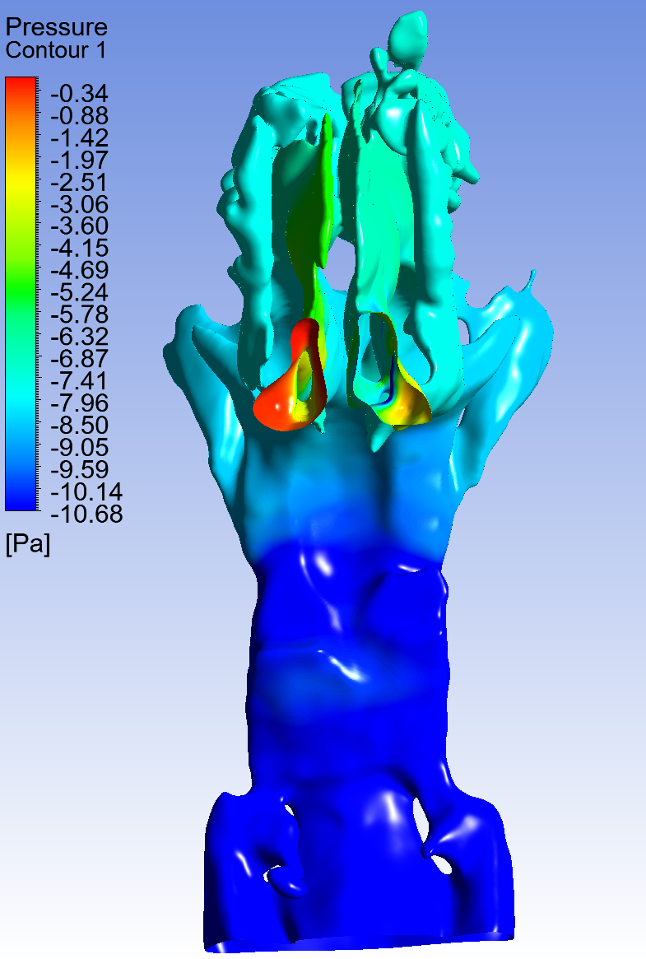
Figures 4 + 5. Pressure contour, frontal view
Higher negative pressures observed pre-expansion.
Pre-expansion
Post-expansion

Slide 29
3. Nasal cavity, pressure and pressure gradient analysis

Slide 30
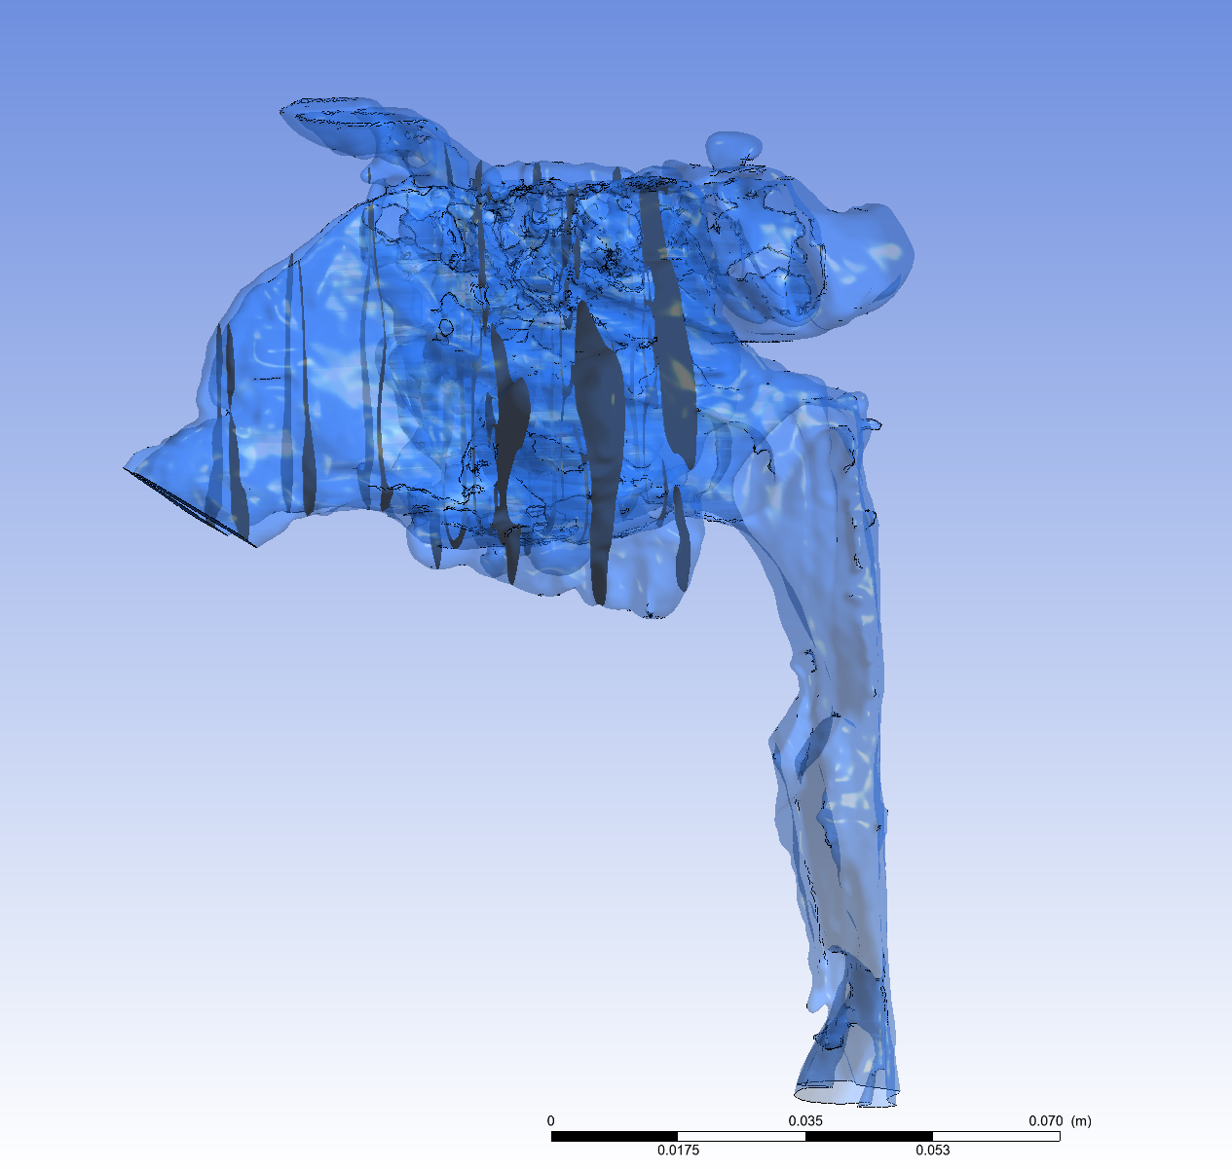
Overview
The nasal cavity was divided into the anterior and medial portion. Three slices and measurements were made each, with the addition of the measurement at the ‘inlet’ of the model, the nostril.
Anterior cavum nasi
Mid-functional
cavum nasi

Slide 31
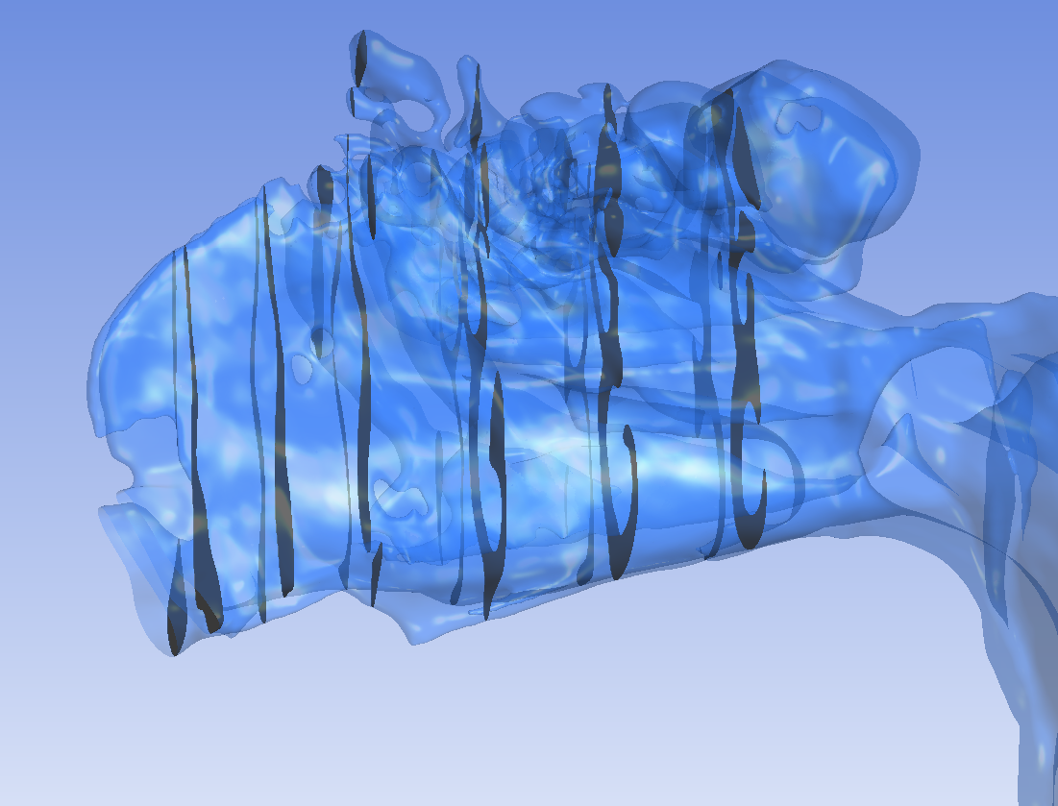
Pre-expansion, 2017:
Area-averaged pressures, in Pa
Anterior cavum
 | Inlet | Plane 1 | Plane 2 | Plane 3 | Total pressure gradient
Average pressure within plane | Right: -0.19 Left: -3.01 Total: -3.20 | -4.19 | -5.99 | -7.08
Pressure gradient |  | 0.99 | 1.8 | 1.09 | 3.88
Mid cavum
 | Plane 3… | Plane 4 | Plane 5 | Plane 6 | Total pressure gradient
Average pressure within plane | -7.08 | -7.38 | -7.57 | -7.75
Pressure gradient |  | 0.3 | 0.19 | 0.18 | 0.67

Slide 32
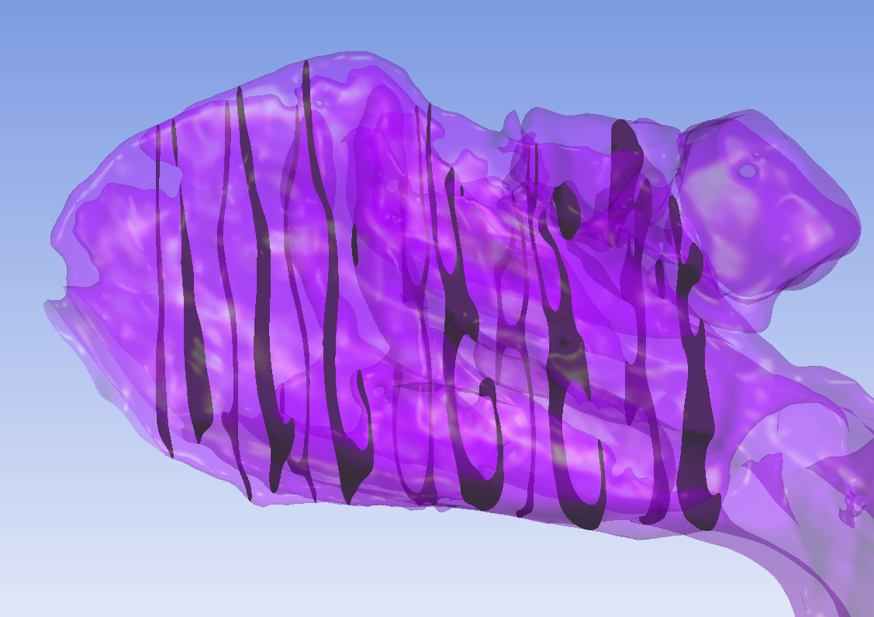
Post-expansion, 2024:
Area-averaged pressures, in Pa
Anterior cavum
 | Inlet | Plane 1 | Plane 2 | Plane 3 | Total pressure gradient
Average pressure within plane | Right: -2.34 Left: -0.53 Total: -2.87 | -3.62 | -3.94 | -4.52
Pressure gradient |  | 0.75 | 0.32 | 0.58 | 1.65
Mid cavum
 | Plane 3… | Plane 4 | Plane 5 | Plane 6 | Total pressure gradient
Average pressure within plane | -4.52 | -4.76 | -5.27 | -5.62
Pressure gradient |  | 0.25 | 0.51 | 0.35 | 1.11

Slide 33
Findings
Overall pressure drop higher pre-expansion than post-expansion (2.76 vs. 4.55)
Overall pressure gradient in the anterior cavum higher than in mid-cavum.
Highest pressure gradient observed towards the middle of the anterior cavum.

Slide 34
4. Velocity findings
Velocity contours with red and yellow areas indicating increased velocity of air flow.

Slide 35
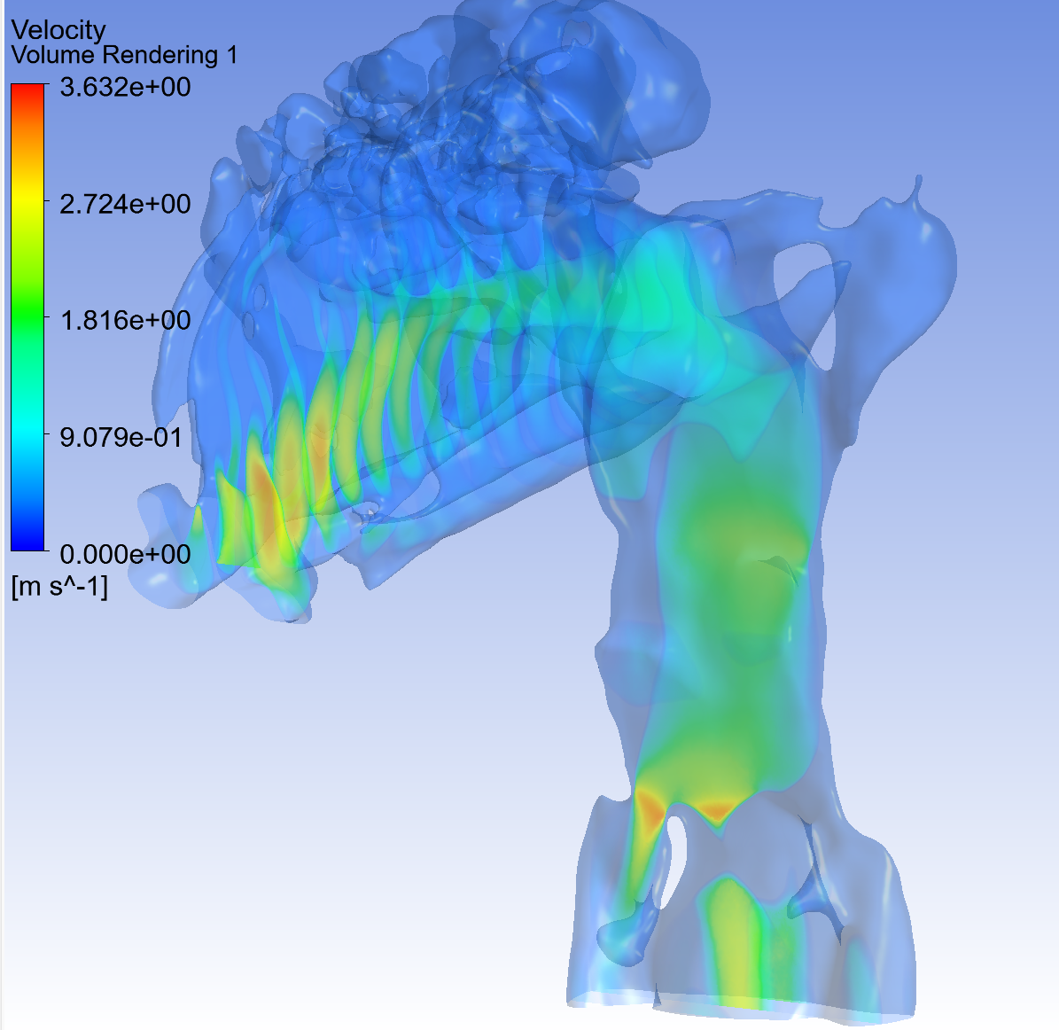
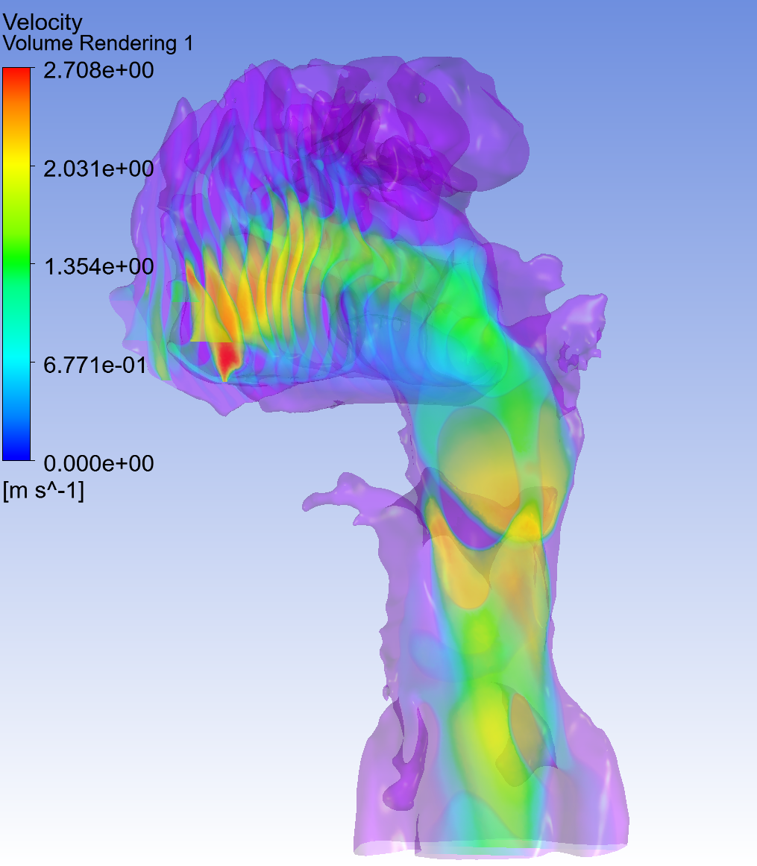
Figures 8+9. Velocity volume rendering pre- and post-expansion
Higher maximum velocities reached pre-expansion
Pre-expansion
Post-expansion

Slide 36
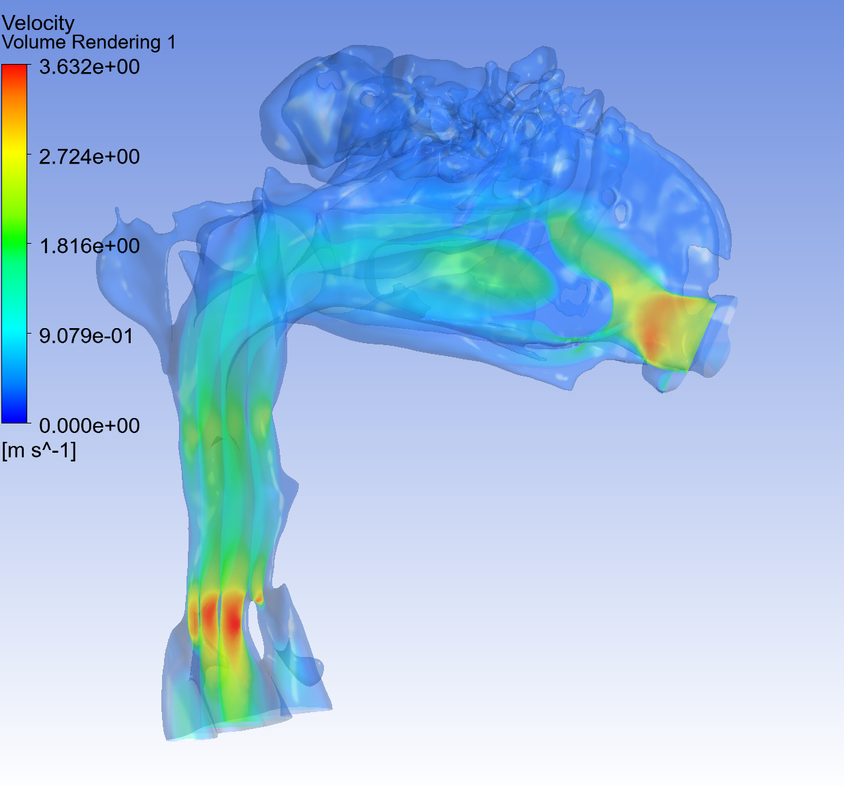
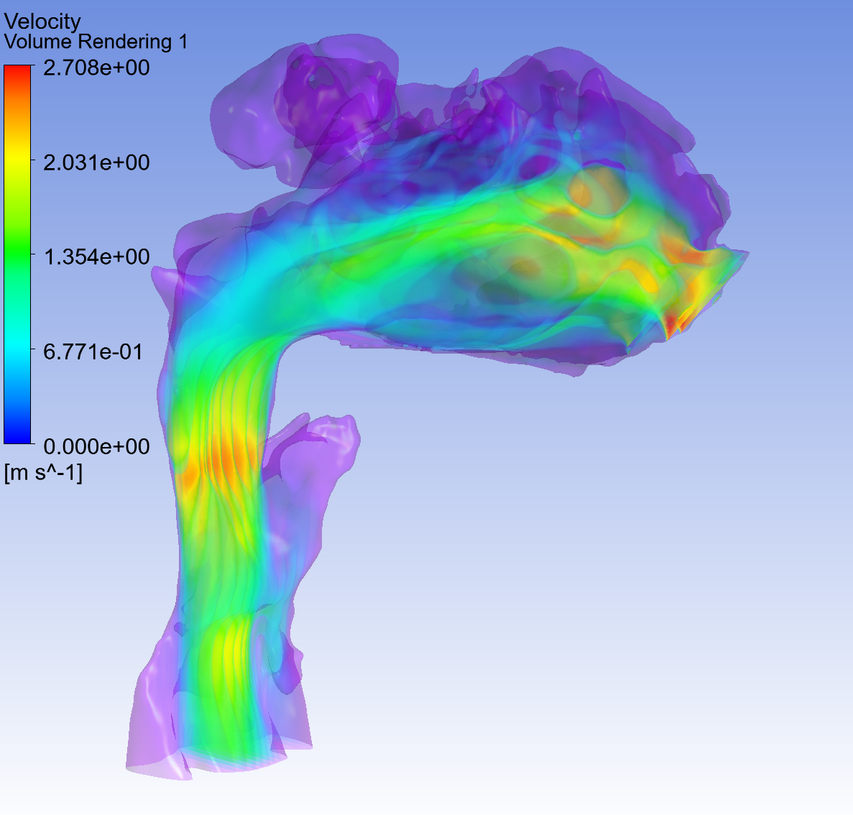
Figures 10+11. Velocity volume rendering pre- and post-expansion
Higher maximum velocities reached pre-expansion
Pre-expansion
Post-expansion

Slide 37
4. Turbulence findings

Slide 38
Pre-expansion, 2017

Slide 39
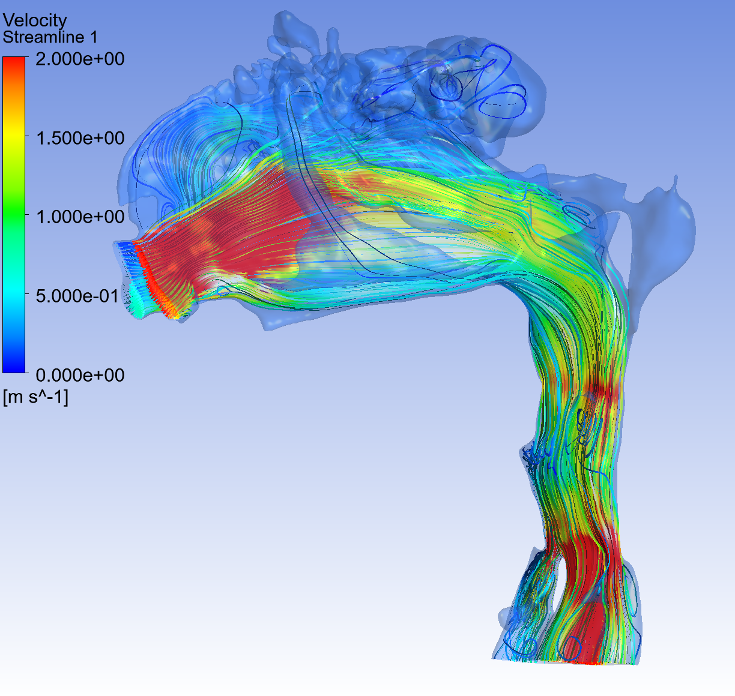
Figure 12.
Left side streamlines indicating airway travel paths and velocities. Boxed areas show recirculation and turbulence.

Slide 40
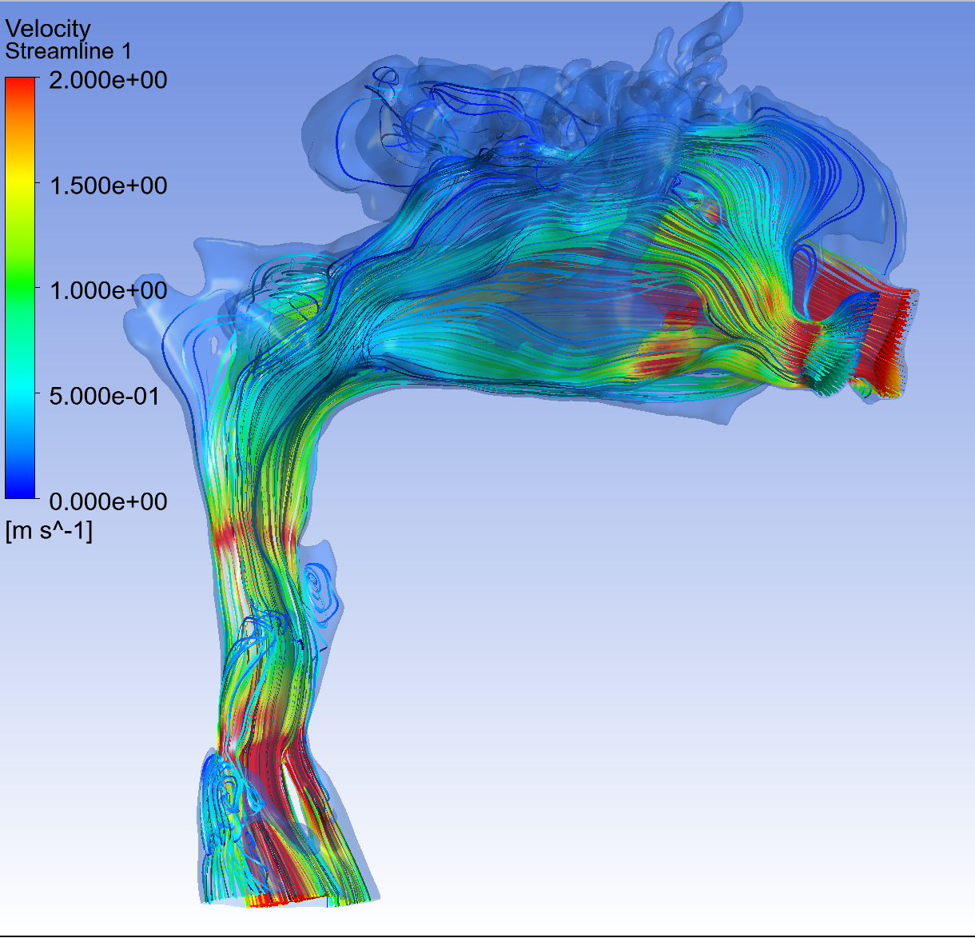
Figure 13.
Right side streamlines indicating airway travel paths and velocities. Higher velocities limited to mostly hypopharyngeal areas.

Slide 41
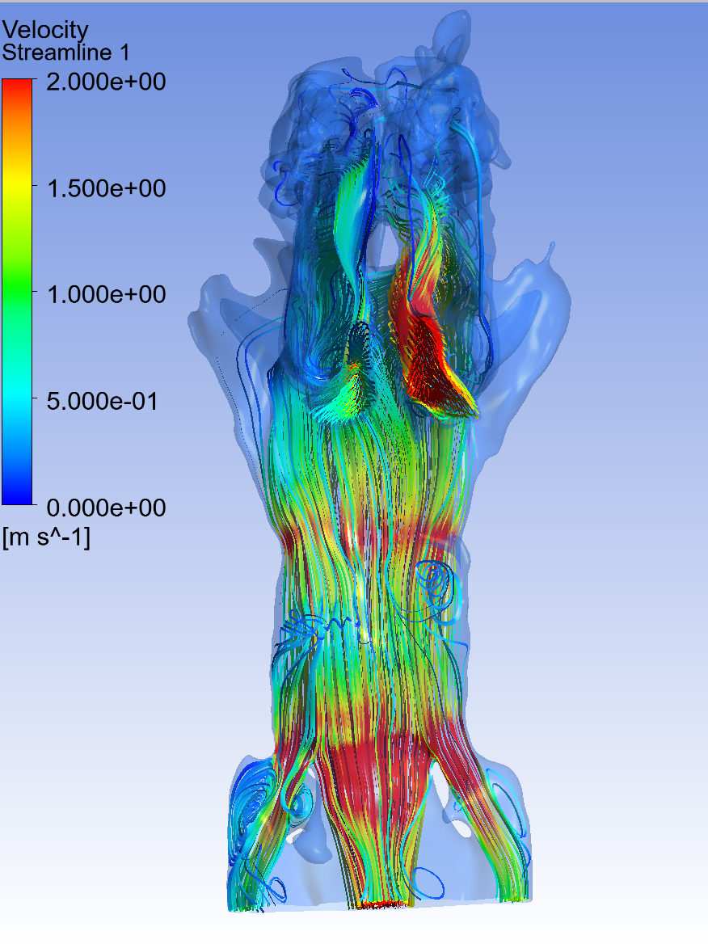
Figure 14. Streamlines indicating travel pathways of air showing some non-laminar flow (boxed areas) in the pharynx.

Slide 42
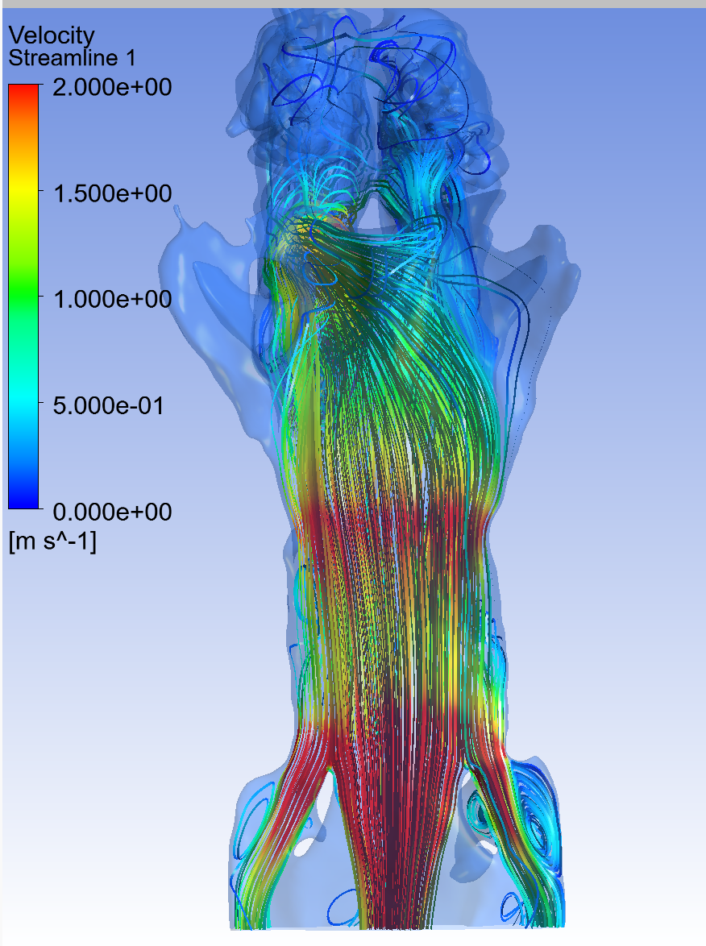
Figure 15.
Airflow streamlines with non-laminar flow in boxed areas.

Slide 43
Post-expansion, 2024

Slide 44
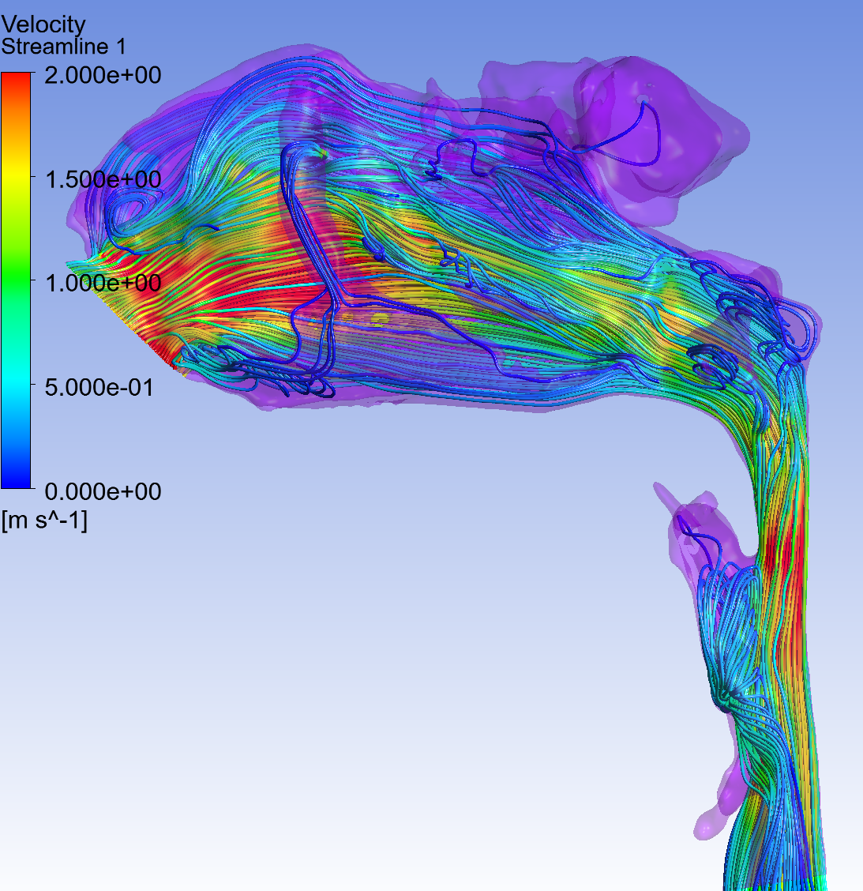
Figure 16.
Left side streamlines indicating airway travel paths and velocities. Boxed areas show recirculation and turbulence.

Slide 45
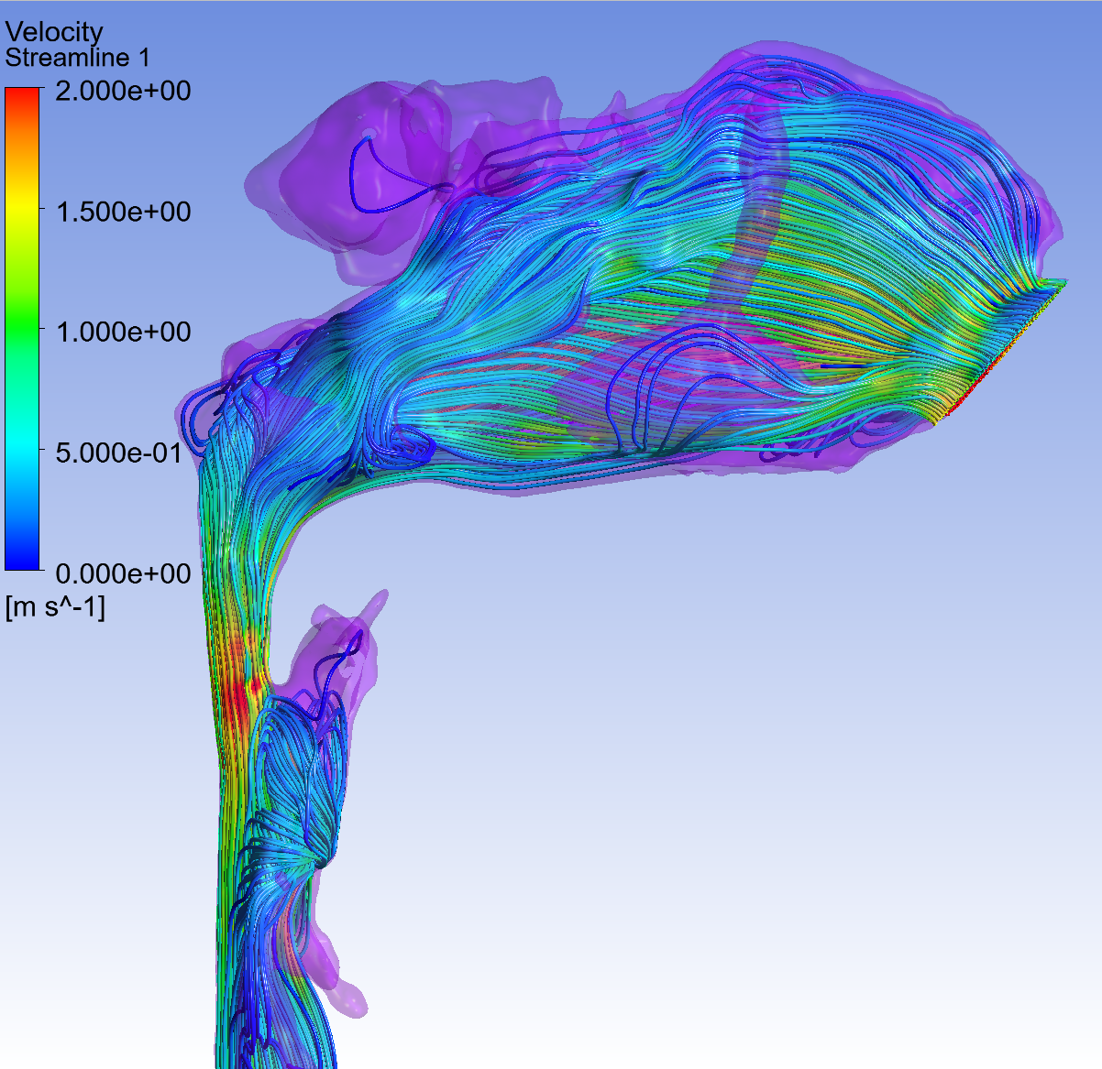
Figure 17.
Right side streamlines indicating airway travel paths and velocities. Mostly laminar flow. Higher velocities limited to mostly hypopharyngeal areas.

Slide 46
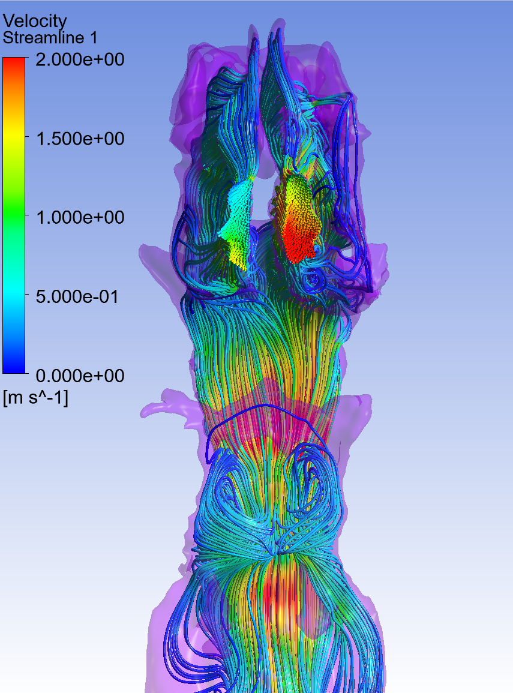
Figure 18. Streamlines indicating travel pathways of air showing some non-laminar flow (boxed areas) in the pharynx.

Slide 47
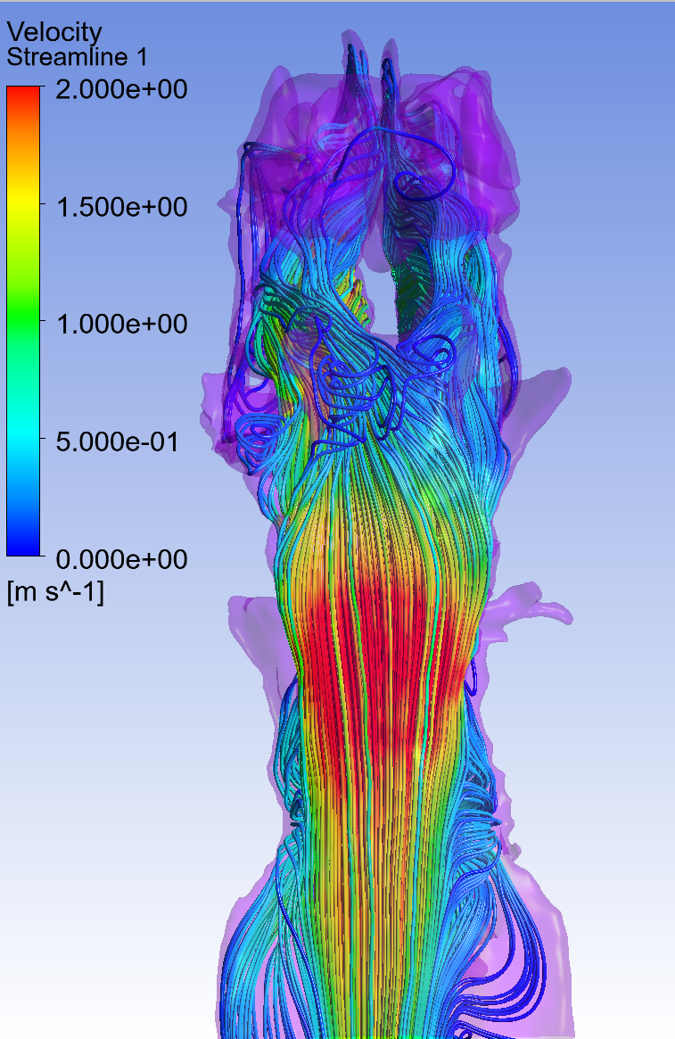
Figure 19. Airflow streamlines with non-laminar flow in boxed areas.

